Slide 1
Database Technologies - MySQL
A day without new knowledge is a lost day.
If A and a, B and b, C and c etc. are treated in the same way then it is case-insensitive. MySQL is case-insensitive
In this module we are going to learn SQL, PL/SQL and NoSQL(MongoDB)

Slide 2
Introduction
If anyone who wants to develop a good application
then he should have the knowledge three major components.
They are . . . . .
Presentation Layer [ UI ]
Application Layer [ Server Application and Client Application ]
Data Layer [ Data Access Object (DAO) / Data Access Layer (DAL) ] { Flat Files | RDBMS | NoSQL }
Why do we need databases (Use Case)?
We need databases because they organize data in a manner which allows us to store, query, sort, and manipulate data in various ways. Databases allow us to do all this things.
Many companies collects data from different resource (like Weather data, Geographical data, Finance data, Scientific data, Transport data, Cultural data [ Cultural means: the ideas, customs, and social behaviour of a particular people or society.. ], etc.)

Slide 3
What is Relation and Relationship?
Remember:
A reference is a relationship between two tables where the values in one table refer to the values in another table.
A referential key is a column or set of columns in a table that refers to the primary key of another table. It establishes a relationship between two tables, where one table is called the parent table, and the other is called the child table.

Slide 4
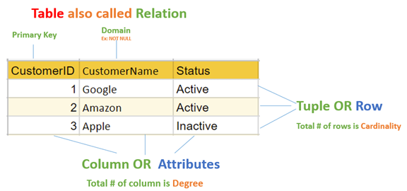
relation and relationship?
Relation (in Relational Algebra "R" stands for relation): In Database, ( a "relation" refers to a table within the database that follows the principles of the relational model OR an entity in ERD ) than contain attributes.
Relationship: In database, relationship is that how the two entities are connected to each other, i.e. what kind of relationship type they hold between them.
Primary/Foreign key is used to specify this relationship.
Remember:
Foreign Key is also know as
referential constraint
referential integrity constraint. (Referential integrity constraint is the state of a database in which all values of all foreign keys are valid.)

Slide 5
File Systems is the traditional way to keep your data organized.
File System
vs
DBMS

Slide 6
file-oriented system
struct Employee {
int emp_no;
char emp_name[50];
int salary;
} emp[1000];
struct Employee {
int emp_no;
char emp_name[50];
int salary;
};
struct Employee emp[1000];
File Anomalies
c:\employee.txt
c:\employee.txt
c:\employee.txt
c:\employee.txt
c:\employee.txt
1 suraj 4000
2 ramesh 6000
3 rajan 4500
. |
. |
. |
500 sam 3500
. |
. |
. |
1000 amit 2300
1 suraj 4000
2 ramesh 6000
3 rajan 4500
. |
. |
. |
500 sam 3500
. |
. |
1000 amit 2300
. |
. |
2000 jerry 4500
. |
. |
1 suraj 4000
2 ramesh 6000
3 rajan 4500
. |
. |
500 sam 3500
. |
3 rajan 4500
. |
sam 3500
. |
. |
1000 amit 2300
1 suraj 4000
2 ramesh 6000
3 rajan 4500
. |
. |
sam 500 3500
. |
ram 550 5000
. |
1000 amit 2300
1 suraj 4000
2 ramesh 6000
3 rajan 4500
. |
500 sam 3500
. |
600 neel 4500

Slide 7
Create/Open an existing file
Reading from file
Writing to a file
Closing a file
file-oriented system
File Anomalies
c:\employee.txt
file attributes
file permissions
search empl ID=1
search emp_name
1 suraj 4000
2 ramesh 6000
3 rajan 4500
. |
. |
. |
500 sam 3500
. |
. |
. |
1000 amit 2300
File Name
Type
Location
File permissions
Share permissions
1 suraj 4000
2 ramesh 6000
3 rajan 4500
. |
. |
. |
500 sam 3500
. |
. |
. |
1000 amit 2300
1 suraj 4000
2 ramesh 6000
3 rajan 4500
. |
. |
. |
500 sam 3500
. |
. |
. |
1000 amit 2300

Slide 8
advantages of file-oriented system
The biggest advantage of file-based storage is that anyone can understand the system.
Advantage of File-oriented system
Backup: It is possible to take faster and automatic back-up of database stored in files of computer-based systems.
Data retrieval: It is possible to retrieve data stored in files in easy and efficient way.
Flexibility: File systems provide flexibility in storing various types of data, including text documents, images, audio, video, and more
Cost-Effectiveness: File systems often do not incur licensing costs, making them cost-effective for basic data storage needs.
Editing: It is easy to edit any information stored in computers in form of files.
Remote access: It is possible to access data from remote location.
Sharing: The files stored in systems can be shared among multiple users at a same time.

Slide 9
disadvantage of file-oriented system
The biggest disadvantage of file-based storage is as follows.
Disadvantage of File-oriented system
Data redundancy: It is possible that the same information may be duplicated in different files. This leads to data redundancy results in memory wastage.
(Suppose a customer having both kind of accounts- saving and current account. In such a situation a customers detail are stored in both the file, saving.txt- file and current.txt- file , which leads to Data Redundancy.)
Data inconsistency: Because of data redundancy, it is possible that data may not be in consistent state.
(Suppose customer changed his/her address. There might be a possibility that address is changed in only one file (saving.txt) and other (current.txt) remain unchanged.)
Limited data sharing: Data are scattered in various files and also different files may have different formats (for example: .txt, .csv, .tsv and .xml) and these files may be stored in different folders so, due to this it is difficult to share data among different applications.
Data Isolation: Because data are scattered in various files, and files may be in different formats (for example: .txt, .csv, .tsv and .xml), writing new application programs to retrieve the appropriate data is difficult.
Data security: Data should be secured from unauthorized access, for example a account holder in a bank should not be able to see the account details of another account holder, such kind of security constraints are difficult to apply in file processing systems.

Slide 10

Relation Schema:
e.g. student (roll_no int, name varchar, address varchar, phone varchar and age int) is relation schema for STUDENT
A relation schema represents name of the relation with its attributes.
DBMS
The database management system (DBMS) is the software that interacts with end users, applications, and the database itself to store and analyze the data.
database: Is the collection of related data which is organized, database can store and retrieve large amount of data easily, which is stored in one or more data files by one or more users, it is called as structured data.
management system: it is a software, designed to define, manipulate, retrieve and manage data in a database.

Slide 11



relational database management system?
A RDBMS is a database management system (DBMS) that is based on the relational model introduced by Edgar Frank Codd at IBM in 1970.
RDBMS supports
client/server Technology
Highly Secured
Relationship (PK/FK)
A server is a computer program or a machine that provides service to another computer program, known as the client.

Slide 12
object relational database management system?
An object database is a database management system in which information is represented in the form of objects.
PostgreSQL is the most popular pure ORDBMS. Some popular databases including Microsoft SQL Server, Oracle, and IBM DB2 also support objects and can be considered as ORDBMS.
Advantage of ORDBMS
Function/Procedure overloading.
Extending server functionality with external functions written in C or Java.
User defined data types.
Inheritance of tables under other tables.

Slide 13
relational model concepts
and
properties of relational table

Slide 14
relational model concepts
Relational model organizes data into one or more tables (or "relations") of columns and rows. Rows are also called records or tuples. Columns are also called attributes.
Tables − In relational model, relations are saved in the form of Tables. A table has rows and columns.
Attribute − Attributes are the properties that define a relation. e.g. (roll_no, name, address, phone and age)
Tuple − A single row of a table, which contains a single record for that relation is called a tuple.
Relation schema − A relation schema describes the relation name (table name) with its attribute (column) names.
Attribute domain − An attribute domain specifies the data type, format, constraints of a column, and defines the range of values that are valid for that column.
Relation key − Each row has one or more attributes, known as relation key, which can identify the row in the relation (table) uniquely.
e.g. student(prn, name, address, phone, DoB, age, hobby, email, status) is relation schema for student relation.
Remember:
In database management systems, NULL is used to represent MISSING or UNKNOWN data in a table column.

Slide 15
properties of relational table
ID | job | firstName | DoB | salary
1 | manager | Saleel Bagde | yyyy-mm-dd | ●●●●●●
3 | salesman | Sharmin | yyyy-mm-dd | ●●●●●●
4 | accountant | Vrushali | yyyy-mm-dd | ●●●●●●
2 | salesman | Ruhan | yyyy-mm-dd | ●●●●●●
5 | 9500 | manager | yyyy-mm-dd | ●●●●●●
5 | Salesman | Rahul Patil | yyyy-mm-dd | ●●●●●●
Relational tables have six properties:
Values are atomic.
Column values are of the same kind. (Attribute Domain: Every attribute has some pre-defined datatypes, format, constraints of a column, and defines the range of values that are valid for that column known as attribute domain.)
Each row is unique.
The sequence of columns is insignificant – (unimportant).
The sequence of rows is insignificant – (unimportant).
Each attribute/column must have a unique name.

Slide 16

What is data?

Slide 17

what is data?
Data is any facts that can be stored and that can be processed by a computer.
Data can be in the form of Text or Multimedia
e.g.
number, characters, or symbol
images, audio, video, or signal
Remember:
A Binary Large Object ( BLOB ) is a MySQL data type that can store binary data such as multimedia, and PDF files.
A Character Large Object(CLOB) is aa MySQL data type which is used to store large amount of textual data. Using this datatype, you can store data up to 2,147,483,647 characters.
A number is a mathematical value used to count, measure, and label.

Slide 18
What is Entity Relationship Diagram?

Slide 19
Entity Relationship Diagram (ER Diagram)
Use E-R model to get a high-level graphical view to describe the "ENTITIES" and their "RELATIONSHIP"
The basic constructs/components of ER Model are
Entity, Attributes and Relationships.

Slide 20
An entity can be a real-world object.
What is Entity?
An entity in DBMS is a real-world object that has certain properties called attributes that define the nature of the entity.

Slide 21
entity
In relation to a database , an entity is a
Person(student, teacher, employee, department, …)
Place(classroom, building, …) --a particular position or area
Thing(computer, lab equipment, …) --an object that is not named
Concept(course, batch, student’s attendance, …) -- an idea,
about which data can be stored. All these entities have some attributes or properties that give them their identity.
Every entity has its own characteristics.

Slide 22
In database management systems, null is used to represent missing or unknown data in a table column.
What is an Attribute?
Attributes are the properties that define a relation.
e.g. student(ID, firstName, middleName, lastName, city)
Entity
a₁
a₂
a₃
a₄
…
v₁
v₂
null
pune
…

Slide 23
attributes
In Entity Relationship(ER) Model attributes can be classified into the following types.
Simple/Atomic and Composite Attribute
Single Valued and Multi Valued attribute
Stored and Derived Attributes
Complex Attribute
Remember:
In SQL, the same name can be used for two (or more) attributes as long as the attributes are in different relations.

Slide 24
attributes
Simple / Atomic Attribute --VS-- Composite Attribute
(Can’t be divided further) (Can be divided further)
Single Value Attribute --VS-- Multi Valued Attribute
(Only One value) (Multiple values)
Stored Attribute --VS-- Derived Attribute
(Only One value) (Virtual)
Complex Attribute
(Composite & Multivalued)
Employee ID: An employee ID can be a composite attribute, which is composed of sub-attributes such as department code, job code, and employee number.
Atomic Attribute: An attribute that cannot be divided into smaller independent attribute is known as atomic attribute.
e.g. ID’s, PRN, age, gender, zip, marital status cannot further divide.
Single Value Attribute: An attribute that has only single value is known as single valued attribute.
e.g. manufactured part can have only one serial number, voter card, blood group, price, quantity, branch can have only one value.
Stored Attribute: The stored attribute are such attributes which are already stored in the database and from which the value of another attribute is derived.
e.g. (HRA, DA…) can be derive from salary, age can be derived from DoB, total marks or average marks of a student can be derived from marks.

Slide 25
Composite VS Multi Valued Attribute

Slide 26

composite / multi valued attributes
Composite Attribute
Person Entity
Name attribute: ( firstName, middleName, and lastName )
PhoneNumber attribute: ( countryCode, cityCode, and phoneNumber )
Multi Valued Attribute
Person Entity
Hobbies attribute: [ reading, hiking, hockey, skiing, photography, . . . ]
SpokenLanguages attribute: [ Hindi, Marathi, Gujarati, English, . . . ]
Degrees attribute: [ 10th , 12th, BE, ME, PhD, . . . ]
emailID attribute: [ saleel@gmail.com, salil@yahoomail.com, . . . ]

Slide 27
What is an Prime, Non-Prime Attribute?
Prime attribute (Entity integrity)
An attribute, which is a part of the prime-key (candidate key), is known as a prime attribute.
Non-prime attribute
An attribute, which is not a part of the prime-key (candidate key), is said to be a non-prime attribute.

Slide 28
Entity Relationship Diagram Symbols

Slide 29
erdplus.com
www.draw.io
entity relationship diagram symbols
Attribute
Composite Attribute
Key Attribute
Strong Entity
Weak Entity
Derived Attribute
Weak Relationship
Relationship
Multivalued Attribute

Slide 30
strong and weak entity
An entity may participate in a relation either totally or partially.
Strong Entity: A strong entity is not dependent on any other entity in the schema. A strong entity will always have a primary key. Strong entities are represented by a single rectangle.
Weak Entity: A weak entity is dependent on a strong entity to ensure its existence. Unlike a strong entity, a weak entity does not have any primary key. A weak entity is represented by a double rectangle. The relation between one strong and one weak entity is represented by a double diamond. This relationship is also known as identifying relationship.
Example 1 – A loan entity can not be created for a customer if the customer doesn’t exist
Example 2 – A payment entity can not be created for a loan if the loan doesn’t exist
Example 3 – A customer address entity can not be created for the customer if the customer doesn’t exist
Example 4 – A prescription entity can not be created for a patient if the patient doesn’t exist

Slide 31
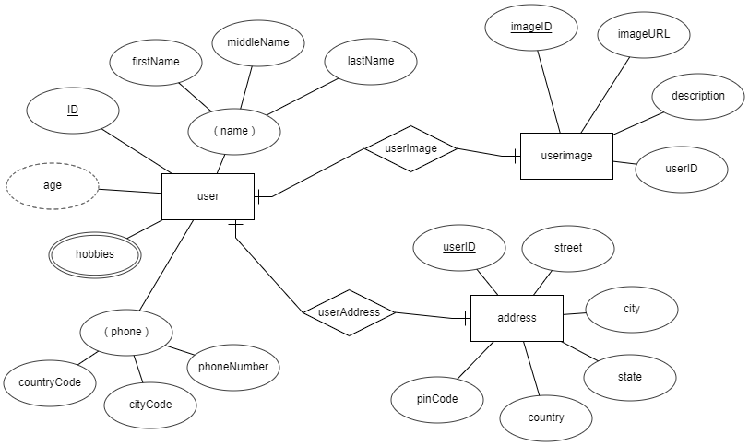
entity relationship diagram
DoB

Slide 32
What is a degree, cardinality, domain and union in database?

Slide 33
What is a degree, cardinality, domain and union in database?
Degree d(R) / Arity: Total number of attributes/columns present in a relation/table is called degree of the relation and is denoted by d(R).
Cardinality |R|: Total number of tuples/rows present in a relation/table, is called cardinality of a relation and is denoted by |R|.
Cardinality is the numerical relationship between rows of one table and rows in another. Common cardinalities include one-to-one, one-to-many, and many-to-many.
Domain: Total range of accepted values for an attribute of the relation is called the domain of the attribute. (Data Type(size))
Union Compatibility: Two relations R and S are set to be Union Compatible to each other if and only if:
They have the same degree d(R).
Domains of the respective attributes should also be same.

Slide 34
What is domain constraint and types of data integrity constraints?

Slide 35
Data integrity refers to the correctness and completeness of data.
A domain constraint and types of data integrity constraints
Domain Constraint = data type + Constraints (not null/unique/primary key/foreign key/check/default)
e.g. custID INT, constraint pk_custid PRIMARY KEY(custID)
Three types of integrity constraints: entity integrity, referential integrity and domain integrity:
Entity integrity: Entity Integrity Constraint is used to ensure the uniqueness of each record the table. There are primarily two types of integrity constraints that help us in ensuring the uniqueness of each row, namely, UNIQUE constraint and PRIMARY KEY constraint.
Referential integrity: Referential Integrity Constraint ensures that there always exists a valid relationship between two tables. This makes sure that if a foreign key exists in a table relationship then it should always reference a corresponding value in the second table t₁[FK] = t₂[PK] or it should be null.
Domain integrity: A domain is a set of values of the same type. For example, we can specify if a particular column can hold null values or not, if the values have to be unique or not, the data type or size of values that can be entered in the column, the default values for the column, etc..

Slide 36
Common relationships

Slide 37

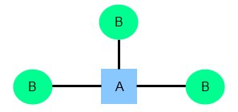
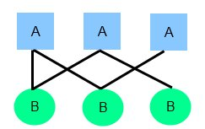
relationships
Common relationship
one-to-one (1:1)
one-to-many (1:M)
many-to-many (M:N)

Slide 38
one-to-one relationship

Slide 39
one-to-one relationship
A one-to-one relationship between two tables means that a row in one table can only relate to zero/one row in the table on the other side of their relationship. This is the least common database relationship.
A one-to-one relationship is a type of cardinality that refers to the relationship between two entities R and S in which one element of entity R may only be linked to zero/one element of entity S, and vice versa.
Country
Capital
Country
Capital
Country
one-to-one relationship
Capital
Country
Capital
=
Country
Capital
Country
Capital

Slide 40
one-to-many relationship

Slide 41
one-to-many relationship
A one-to-many relationship between two tables means that a row in one table can have zero or more row in the table on the other side of their relationship.
a one-to-many relationship is a type of cardinality that refers to the relationship between two entities R and S in which an element of R may be linked to many elements of S, but a member of S is linked to only one element of R.
Customer-1
Order-1
Customer-1
Order-1
Customer-2
Order-1
Customer-2
Order-1
one-to-many relationship
Customer-3
Order-2
=
Customer-2
Order-2
Customer-4
Order-1
Customer-3
Order-1
Customer-5
Order-2
Customer-3
Order-2
Order-3
Customer-3
Order-3
Order-1
Customer-4
Order-1

Slide 42
many-to-many relationship

Slide 43
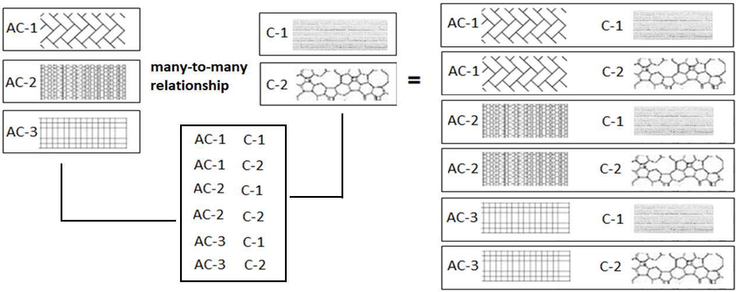
many-to-many relationship
A many-to-many relationship is a type of cardinality that refers to the relationship between two entities R and S in which R may contain a parent instance for which there are many children in S and vice versa.
=
=

Slide 44
Schema: A schema is a collection of database objects (like table, columns , primary key, foreign key, views, etc.) associated with one particular database username. This username is called the schema owner. You may have one or multiple schemas in a database.
erdplus.com
www.draw.io
What is schema and instance
Instance
The data stored in database at a particular moment of time is called instance of database.
For example, lets say we have a single table student in the database, today the table has 100 records, so today the instance of the database has 100 records. Lets say we are going to add another 100 records in this table by tomorrow so the instance of database tomorrow will have 200 records in table.
An instance of a relation is a set of tuples, also called records

Slide 45

MySQL
MySQL is the most popular Open Source
Relational Database Management System.
MySQL was created by a Swedish company - MySQL AB that was founded in 1995. It was acquired by Sun Microsystems in 2008; Sun was in turn acquired by Oracle Corporation in 2010.
When you use MySQL, you’re actually using at least two programmes. One program is the MySQL server (mysqld.exe) and other program is MySQL client program (mysql.exe) that connects to the database server.

Slide 46
What is SQL?

Slide 47

what is sql?
Remember:
EXPLICIT or IMPLICIT commit will commit the data.
SQL (Structured Query Language) is a database language designed and developed for managing data in relational database management systems (RDBMS). SQL is common language for all Relational Databases.

Slide 48
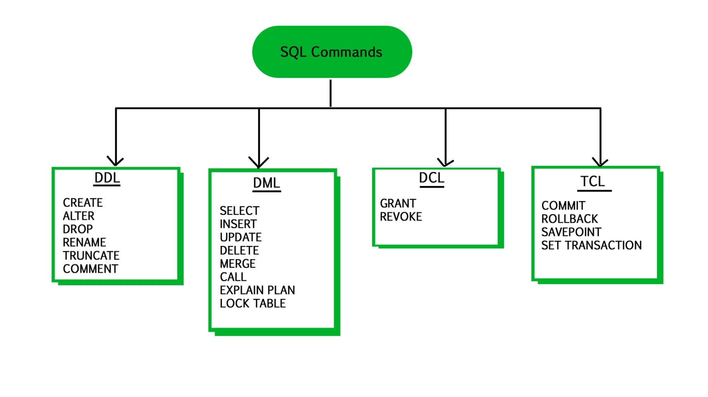
what is sql?
Remember:
An EXPLICIT commit happens when we execute an SQL "COMMIT" command.
An IMPLICIT commits occur without running a "COMMIT" command.
Remember:
A NULL value is not treated as a blank or 0. Null or NULL is a special marker used in Structured Query Language to indicate that a data value does not exist or missing or unknown in the database.
Degree d(R): Total no. of attributes/columns present in a relation/table is called degree of the relation and is denoted by d(R).
Cardinality |R|: Total no. of tuples present in a relation or Rows present in a table, is called cardinality of a relation and is denoted by |R|.

Slide 49
comments in mysql
From a # character to the end of the line.
From a -- sequence to the end of the line.
From a /* sequence to the following */ sequence.
Reconnect to the server | \r
Execute a system shell command | \!
Exit mysql | \q
Change your mysql prompt. | prompt str or \R str

Slide 50
Login to MySQL

Slide 51
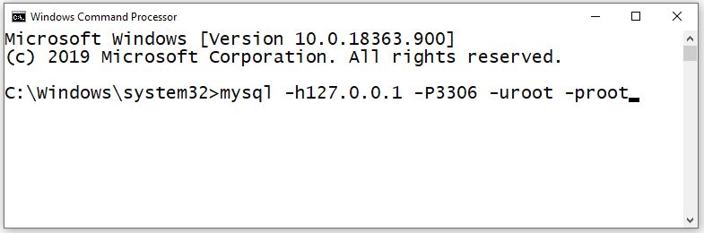
login
Default port for MySQL Server: 3306
C:\> mysql -hlocalhost -P3307 -uroot -p
C:\> mysql -h127.0.0.1 -P3307 -uroot -p [database_name]
C:\> mysql -h192.168.100.14 -P3307 -uroot -psaleel [database_name]
C:\> mysql --host localhost --port 3306 --user root --password=ROOT [database_name]
C:\> mysql --host=localhost --port=3306 --user=root --password=ROOT [database_name]

Slide 52
The char is a fixed-length character data type,
The varchar is a variable-length character data type.
datatypes
ENAME CHAR (10) | S | A | L | E | E | L |  |  |  |  | LENGTH -> 6
ENAME VARCHAR(10) | S | A | L | E | E | L |  |  |  |  | LENGTH -> 6
When CHAR values are retrieved, the trailing spaces are removed (unless the PAD_CHAR_TO_FULL_LENGTH SQL mode is enabled)
In MySQL
Note:
The BINARY and VARBINARY types are similar to CHAR and VARCHAR, except that they store binary strings rather than nonbinary strings. That is, they store byte strings rather than character strings.

Slide 53
datatype - string
Datatypes | Size | Description
CHAR [(length)] | 0-255
VARCHAR (length) | 0 to 65,535 | The maximum row size (65,535 bytes, which is shared among all columns.
TINYTEXT [(length)] | (2⁸ − 1) bytes
TEXT [(length)] | (2¹⁶ -1) bytes | 65,535 bytes ~ 64kb
MEDIUMTEXT [(length)] | (2²⁴ -1) bytes | 16,777,215 bytes ~16MB
LONGTEXT [(length)] | (2³² -1) bytes | 4,294,967,295 bytes ~4GB
ENUM('value1', 'value2',...) | 65,535 members
SET('value1', 'value2',...) | 64 members
BINARY[(length)] | 255
VARBINARY(length)

Slide 54
datatype - numeric
Datatypes | Size | Description
TINYINT | 1 byte | -128 to +127 (The unsigned range is 0 to 255).
SMALLINT [(length)] | 2 bytes | -32768 to 32767. (The unsigned range is 0 to 65535).
MEDIUMINT [(length)] | 3 bytes | -8388608 to 8388607. (The unsigned range is 0 to 16777215).
INT, INTEGER [(length)] | 4 bytes | -2147483648 to 2147483647. (The unsigned range is 0 to 4294967295).
BIGINT [(length)] | 8 bytes | -9,223,372,036,854,775,808 to 9,223,372,036,854,775,807
FLOAT [(length[,decimals])] | 4 bytes | FLOAT(255,30)
DOUBLE [PRECISION] [(length[,decimals])], REAL [(length[,decimals])] | 8 bytes | REAL(255,30) / DOUBLE(255,30) REAL will get converted to DOUBLE
DECIMAL [(length[,decimals])], NUMERIC [(length[,decimals])] |  | DECIMAL(65,30) / NUMERIC(65,30) NUMERIC will get converted in DECIMAL
UNSIGNED prohibits negative values.

Slide 55
datatype – date and time
Datatypes | Size | Description
YEAR | 1 byte | YYYY
DATE | 3 bytes | YYYY-MM-DD
TIME | 3 bytes | HH:MM:SS
DATETIME | 8 bytes | YYYY-MM-DD hh:mm:ss

Slide 56
Use a CREATE TABLE statement to specify the layout of your table.
Remember:
Max 4096 columns per table provided the row size <= 65,535 Bytes
create table
Use a CREATE TABLE statement to specify the layout of your table.
Note:
USER TABLES: This is a collection of tables created and maintained by the user. Contain USER information.
DATA DICTIONARY: This is a collection of tables created and maintained by the MySQL Server. It contains database information. All data dictionary tables are owned by the SYS user.

Slide 57
create table
Use a CREATE TABLE statement to specify the layout of your table.
Remember:
by default, tables are created in the default database, using the InnoDB storage engine.
table name should not begin with a number or special symbols.
table name can start with _table_name (underscore) or $table_name (dollar sign)
table name and column name can have max 64 char.
multiple words as table_name is invalid, if you want to give multiple words as table_name then give it in `table_name` (backtick)
error occurs if the table exists.
error occurs if there is no default database.
error occurs if the database does not exist.
Note:
Table names are stored in lowercase on disk. MySQL converts all table names to lowercase on storage. This behavior also applies to database names and table aliases.
e.g. show variables like 'lower_case_table_names';

Slide 58
create table
syntax
e.g.
CREATE TABLE student (
ID INT,
firstName VARCHAR(45),
lastName VARCHAR(45),
DoB DATE,
emailID VARCHAR(128)
);
CREATE [TEMPORARY] TABLE [IF NOT EXISTS] tbl_name
(create_defineation, . . .)
[table_options]
[partition_options]
create_definition:
col_name column_definition
column_definition:
data_type [NOT NULL | NULL] [DEFAULT default_value]
[AUTO_INCREMENT] [UNIQUE [KEY] | [PRIMARY] KEY]
[reference_definition]
| data_type [GENERATED ALWAYS] AS (expression) [VIRTUAL]
[VISIBLE | INVISIBLE]
table_options:
ENGINE [=] engine_name
show engines;
set default_storage_engine = memory;

Slide 59
col_name data_type DEFAULT value
default value
The DEFAULT specifies a default value for the column.
BLOB, TEXT, GEOMETRY or JSON column can't have a default value.
e.g. CREATE TABLE temp(c1 TEXT DEFAULT('PUNE'));

Slide 60
INSERT [IGNORE] [INTO] tbl_name [PARTITION (partition_name [, partition_name] ...)] [ (col_name, . . .) ] { VALUES | VALU E } ( { expr | DEFAULT }, . . .), (. . .), . . .
insert rows
INSERT is used to add a single or multiple tuple to a relation. We must specify the relation name and a list of values for the tuple. The values should be listed in the same order in which the corresponding attributes were specified in the CREATE TABLE command.
You can insert data using following methods:
INSERT ... VALUES
INSERT ... SET
INSERT ... SELECT

Slide 61
Do not use the * operator in your SELECT statements. Instead, use column names. Reason is that in MySQL Server scans for all column names and replaces the * with all the column names of the table(s) in the SELECT statement. Providing column names avoids this search-and-replace, and enhances performance.
SELECT statement…
SELECT what_to_select
FROM which_table
WHERE conditions_to_satisfy;

Slide 62
SELECT CLAUSE
The SELECT statement retrieves or extracts data from tables in the database.
You can use one or more tables separated by comma to extract data.
You can fetch one or more fields/columns in a single SELECT command.
You can specify star (*) in place of fields. In this case, SELECT will return all the fields.
SELECT can also be used to retrieve rows computed without reference to any table e.g. SELECT 1 + 2;

Slide 63
Capabilities of SELECT Statement
SELECTION
PROJECTION
JOINING

Slide 64
Capabilities of SELECT Statement
SELECTION
Selection capability in SQL is to choose the record’s/row’s/tuple’s in a table that you want to return by a query.
R
EMPNO | ENAME | JOB | HIREDATE | DEPTNO
1 | Saleel | Manager | 1995-01-01 | 10
2 | Janhavi | Sales | 1994-12-20 | 20
3 | Snehal | Manager | 1997-05-21 | 10
4 | Rahul | Account | 1997-07-30 | 10
5 | Ketan | Sales | 1994-01-01 | 30

Slide 65
Capabilities of SELECT Statement
PROJECTION
Projection capability in SQL to choose the column’s/attribute’s/field’s in a table that you want to return by your query.
R
EMPNO | ENAME | JOB | HIREDATE | DEPTNO
1 | Saleel | Manager | 1995-01-01 | 10
2 | Janhavi | Sales | 1994-12-20 | 20
3 | Snehal | Manager | 1997-05-21 | 10
4 | Rahul | Account | 1997-07-30 | 10
5 | Ketan | Sales | 1994-01-01 | 30

Slide 66

Capabilities of SELECT Statement
JOINING
Join capability in SQL to bring together data that is stored in different tables by creating a link between them.
R
S
EMPNO | ENAME | JOB | HIREDATE | DEPTNO
1 | Saleel | Manager | 1995-01-01 | 20
2 | Janhavi | Sales | 1994-12-20 | 10
3 | Snehal | Manager | 1997-05-21 | 10
4 | Rahul | Account | 1997-07-30 | 20
5 | Ketan | Sales | 1994-01-01 | 30
DEPTNO | DNAME | LOC
10 | HRD | PUNE
20 | SALES | BARODA
40 | PURCHASE | SURAT

Slide 67
select statement
SELECTION Process
SELECT * FROM <table_references>
selection-list | field-list | column-list
Remember:
Here, " * " is known as metacharacter (all columns)
PROJECTION Process
SELECT column-list FROM <table_references>
selection-list | field-list | column-list
Remember:
Position of columns in SELECT statement will determine the position of columns in the output (as per user requirements)

Slide 68
UPDATE tbl_name SET col_name1 = { expr1 | DEFAULT } [, col_name2 = { expr2 | DEFAULT } ] . . .
[WHERE where_condition]
In a SET statement, = is treated identically to :=
single-table update
UPDATE is used to change/modify the values of some attributes of one or more selected tuples.

Slide 69
DELETE FROM tbl_name
[WHERE where_condition]
single-table delete
DELETE is used to delete tuples from a relation.

Slide 70
constraints
CONSTRAINT is used to define rules to allow or restrict what values can be stored in columns. The purpose of inducing constraints is to enforce the integrity of a database.
CONSTRAINTS can be classified into two types –
Column Level
Table Level

Slide 71
Remember:
PRI => primary key
UNI => unique key
MUL=> is basically an index that is neither a primary key nor a unique key. The name comes from
"multiple" because multiple occurrences of the same value are allowed.
constraints
To limit or to restrict or to check or to control.
Note:
a table with a foreign key that references another table's primary key is MUL.
If more than one of the Key values applies to a given column of a table, Key displays the one with the highest priority, in the order PRI, UNI, and MUL.
If a table has a PRIMARY KEY or UNIQUE NOT NULL index that consists of a single column that has an integer type, you can use _rowid to refer to the indexed column in SELECT statements.

Slide 72
Remember:
A primary key cannot be NULL.
A primary key value must be unique.
A table has only one primary key.
The primary key values cannot be changed, if it is referred by some other column.
An index can consist of 16 columns, at maximum. Since a PRIMARY KEY constraint automatically adds an index, it can't have more than 16 columns.
col_name data_type PRIMARY KEY
PRIMARY KEY constraint
A primary key is a special column (or set of combined columns) in a relational database table, that is used to uniquely identify each record.
Note:
Primary key in a relation is always associated with an INDEX object.
If, we give on a column a combination of NOT NULL & UNIQUE key then it behaves like a PRIMARY key.
If, we give on a column a combination of UNIQUE key & AUTO_INCREMENT then also it behaves like a PRIMARY key.

Slide 73
ALTER TABLE table_name
ADD [ CONSTRAINT constraint_name ]
PRIMARY KEY (column1, column2, . . . column_n)
Add / Drop Primary Key
ALTER TABLE table_name
DROP PRIMARY KEY

Slide 74
Remember:
A unique key can be NULL.
A unique key value must be unique.
A table can have multiple unique key.
A column can have unique key as well as a primary key.
col_name data_type UNIQUE KEY
UNIQUE KEY constraint
A UNIQUE key constraint is a set of one or more than one fields/columns of a table that uniquely identify a record in a database table.
Note:
Unique key in a relation is always associated with an INDEX object.

Slide 75
ALTER TABLE table_name
ADD [ CONSTRAINT constraint_name ]
UNIQUE (column1, column2, . . . column_n)
Add / Drop Unique Key
ALTER TABLE table_name
DROP INDEX constraint_name;

Slide 76
[CONSTRAINT [symbol]] FOREIGN KEY (col_name, ...) REFERENCES tbl_name (col_name,...)
[ON DELETE reference_option]
[ON UPDATE reference_option]
reference_option: CASCADE | SET NULL
FOREIGN KEY constraint
A FOREIGN KEY is a key used to link two tables together.
A FOREIGN KEY is a field (or collection of fields) in one table that refers to the PRIMARY KEY in another table.
The table containing the foreign key is called the child table, and the table containing the candidate key is called the referenced or parent table.

Slide 77
constraints – foreign key
Remember:
A foreign key can have a different column name from its primary key.
DataType of primary key and foreign key column must be same.
It ensures rows in one table have corresponding rows in another.
Unlike the Primary key, they do not have to be unique.
Foreign keys can be null even though primary keys can not.
Note:
The table containing the FOREIGN KEY is referred to as the child table, and the table containing the PRIMARY KEY (referenced key) is the parent table.
PARENT and CHILD tables must use the same storage engine,
and they cannot be defined as temporary tables.

Slide 78
ALTER TABLE table_name
ADD [ CONSTRAINT constraint_name ]
FOREIGN KEY (child_col1, child_col2, . . . child_col_n)
REFERENCES parent_table (parent_col1, parent_col2, . . . parent_col_n);
Add / Drop Foreign Key
ALTER TABLE table_name
DROP FOREIGN KEY constraint_name

Slide 79
col_name data_type CHECK (expr)
Check Constraint

Slide 80
constraints – check
CHECK condition expressions must follow some rules.
Literals, deterministic built-in functions, and operators are permitted.
Non-generated and generated columns are permitted, except columns with the AUTO_INCREMENT attribute.
Sub-queries are not permitted.
Environmental variables (such as CURRENT_USER, CURRENT_DATE, …) are not permitted.
Non-Deterministic built-in functions (such as AVG, COUNT, RAND, LAST_INSERT_ID, FIRST_VALUE, LAST_VALUE, ...) are not permitted.
Variables (system variables, user-defined variables, and stored program local variables) are not permitted.
Stored functions and user-defined functions are not permitted.
Note:
Prior to MySQL 8.0.16, CREATE TABLE permits only the following limited version of table CHECK constraint syntax, which is parsed and ignored.
Remember:
If you omit the constraint name, MySQL automatically generates a name with the following convention:
table_name_chk_n

Slide 81
ALTER TABLE table_name
ADD [ CONSTRAINT constraint_name ]
CHECK (conidiation)
Add / Drop Check Constraint
ALTER TABLE table_name
DROP { CHECK | CONSTRAINT } constraint_name

Slide 82
alter table
ALTER TABLE changes the structure of a table.
Note:
you can add or delete columns,
create or destroy indexes,
change the type of existing columns, or
rename columns or the table itself.
You cannot change the position of columns in table structure. If not, then what? create a new table with SELECT statement.

Slide 83
alter table
syntax
ALTER TABLE tbl_name
[alter_specification [, alter_specification] . . .
| ADD [COLUMN] col_name column_definition [FIRST | AFTER col_name ]
| ADD [COLUMN] (col_name column_definition, . . .)
| MODIFY [COLUMN] col_name column_definition [FIRST | AFTER col_name]
| DROP [COLUMN] col_name
| RENAME [TO|AS] new_tbl_name
| RENAME COLUMN old_col_name TO new_col_name
| ALTER [COLUMN] col_name { SET DEFAULT {literal | (expr)} | DROP DEFAULT | SET { VISIBLE | INVISIBLE}}

Slide 84
DROP [TEMPORARY] TABLE [IF EXISTS] tbl_name [, tbl_name] ...
drop table
Remember:
DROP and TRUNCATE are DDL commands, whereas DELETE is a DML command.
DELETE operations can be rolled back (undone), while DROP and TRUNCATE operations cannot be rolled back (DDL statements are auto committed).
Dropping a TABLE also drops any TRIGGERS for the table.
Dropping a TABLE also drops any INDEX for the table.
Dropping a TABLE will not drops any VIEW for the table.
If you try to drop a PARENT/MASTER TABLE, it will not get dropped.

Slide 85
create temporary table
Note:
it is possible to create, alter, drop, and write (Insert, Update, and Delete rows) to TEMPORARY tables.

Slide 86
temporary table
Remember:
You can use the TEMPORARY keyword when creating a table.
A TEMPORARY table is visible only to the current session, and is dropped automatically when the session is closed.
Use TEMPORARY table with the same name as the original can be useful when you want to try some statements that modify the contents of the table, without changing the original table.
The permanent (original) table becomes hidden (inaccessible) to the client who creates the TEMPORARY table with same name as the original.
If you issue a DROP TABLE statement, the TEMPORARY table is removed and the original table reappears, it is possible, only when then original tbl_name and temporary tbl_name are same.
The original table also reappears if you rename the TEMPORARY table.
e.g. ALTER TABLE dept RENAME TO d;
Temporary table_name

Slide 87
Do not use the * operator in your SELECT statements. Instead, use column names. Reason is that in MySQL Server scans for all column names and replaces the * with all the column names of the table(s) in the SELECT statement. Providing column names avoids this search-and-replace, and enhances performance.
continue with SELECT statement…
SELECT what_to_select
FROM which_table
WHERE conditions_to_satisfy;
The asterisk symbol “ * ” can be used in the SELECT clause to denote “all attributes.”

Slide 88
SELECT CLAUSE
The SELECT statement retrieves or extracts data from tables in the database.
You can use one or more tables separated by comma to extract data.
You can fetch one or more fields/columns in a single SELECT command.
You can specify star (*) in place of fields. In this case, SELECT will return all the fields.
SELECT can also be used to retrieve rows computed without reference to any table e.g. SELECT 1 + 2;

Slide 89
Capabilities of SELECT Statement
SELECTION
PROJECTION
JOINING

Slide 90
Capabilities of SELECT Statement
SELECTION
Selection capability in SQL is to choose the rows in a table that you want to return by a query.
R
EMPNO | ENAME | JOB | HIREDATE | DEPTNO
1 | Saleel | Manager | 1995-01-01 | 10
2 | Janhavi | Sales | 1994-12-20 | 20
3 | Snehal | Manager | 1997-05-21 | 10
4 | Rahul | Account | 1997-07-30 | 10
5 | Ketan | Sales | 1994-01-01 | 30

Slide 91
Capabilities of SELECT Statement
PROJECTION
Projection capability in SQL to choose the columns in a table that you want to return by your query.
R
EMPNO | ENAME | JOB | HIREDATE | DEPTNO
1 | Saleel | Manager | 1995-01-01 | 10
2 | Janhavi | Sales | 1994-12-20 | 20
3 | Snehal | Manager | 1997-05-21 | 10
4 | Rahul | Account | 1997-07-30 | 10
5 | Ketan | Sales | 1994-01-01 | 30

Slide 92
Capabilities of SELECT Statement
JOINING
Join capability in SQL to bring together data that is stored in different tables by creating a link between them.
R
S
EMPNO | ENAME | JOB | HIREDATE | DEPTNO
1 | Saleel | Manager | 1995-01-01 | 20
2 | Janhavi | Sales | 1994-12-20 | 10
3 | Snehal | Manager | 1997-05-21 | 10
4 | Rahul | Account | 1997-07-30 | 20
5 | Ketan | Sales | 1994-01-01 | 30
DEPTNO | DNAME | LOC
10 | HRD | PUNE
20 | SALES | BARODA
40 | PURCHASE | SURAT

Slide 93
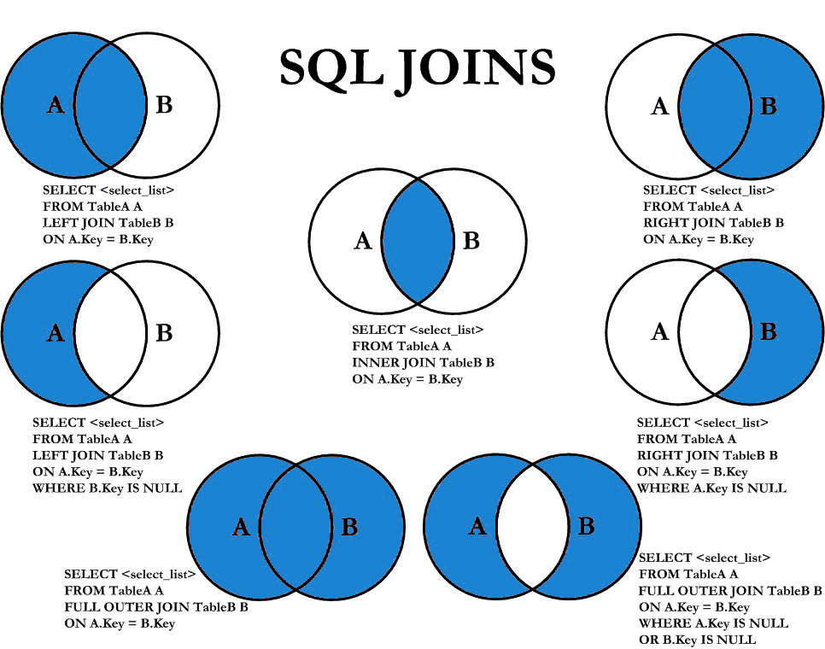

Slide 94
select statement
SELECTION Process
SELECT * FROM <table_references>
selection-list | field-list | column-list
Remember:
Here, " * " is known as metacharacter (all columns)
PROJECTION Process
SELECT column-list FROM <table_references>
selection-list | field-list | column-list
Remember:
Position of columns in SELECT statement will determine the position of columns in the output (as per
user requirements)

Slide 95
column - alias
A programmer can use an alias to temporarily assign another name to a column or table for the duration of a SELECT query.
In the selection-list, a quoted column alias can be specified using identifier ( ` ) or string quote ( ' or " ) characters.
Note:
Assigning an alias_name does not actually rename the column or table.
You cannot use alias in an expression.

Slide 96
select statement - alias
SELECT A₁ [ [AS] alias_name], A₂ [ [AS] alias_name], . . ., A_{N} FROM r [ [AS] alias_name]
column-name as new-name
table-name as new-name
Remember:
A select_expr can be given an alias using AS alias_name. The alias is used as the expression's column name and can be used in GROUP BY, HAVING, or ORDER BY clauses.
The AS keyword is optional when aliasing a select_expr with an identifier.
Standard SQL disallows references to column aliases in a WHERE clause.
A table reference can be aliased using tbl_name alias_name or tbl_name AS alias_name
If the column alias contains spaces, put it in quotes.
Alias name is max 256 characters.

Slide 97
assignment _operator
= (assignment), :=
comparison functions and operator
Comparison operations result in a value of 1 (TRUE), 0 (FALSE), or NULL.

Slide 98
comparison functions and operator
arithmetic_operators:
* | / | DIV | % |MOD | - | +
comparison_operator:
= | <=> | >= | > | <= | < | <> | !=
boolean_ predicate:
IS [NOT] NULL
| expr <=> null
predicate:
expr [NOT] LIKE expr [ESCAPE char]
| expr [NOT] IN (expr1, expr2, . . . )
| expr [NOT] IN (subquery)
| expr [NOT] BETWEEN expr1 AND expr2
logical_operators
{ AND | && } | { OR | || }
assignment _operator
= (assignment), :=
operand meaning: the quantity on which an operation is to be done.
SELECT 23 DIV 6 ; #3
SELECT 23 / 6 ; #3 .8333
Note:
AND has higher precedence than OR.

Slide 99
column - expressions

Slide 100
select statement - expressions
Column EXPRESSIONS
SELECT A₁, A₂, A₃, A₄, expressions, . . . FROM r
SELECT 1001 + 1;
SELECT 1001 + '1';
SELECT '1' + '1' ;
SELECT '1' + 'a1';
SELECT '1' + '1a';
SELECT 'a1' + 1;
SELECT '1a' + 1;
SELECT 1 + -1;
SELECT 1 + -2;
SELECT -1 + -1;
SELECT -1 - 1;
SELECT -1 - -1;
SELECT 123 * 1;
SELECT -123 * 1;
SELECT 123 * -1 ;
SELECT -123 * -1;
SELECT 2 * 0;
SELECT 2435 / 1;
SELECT 2 / 0;
SELECT '2435Saleel' / 1;
SELECT sal, sal + 1000 AS 'New Salary' FROM emp;
SELECT sal, comm, sal + comm FROM emp;
SELECT sal, comm, sal + IFNULL(comm, 0) FROM emp;
SELECT ename, ename = ename FROM emp;
SELECT ename, ename = 'smith' FROM emp;
SELECT c1, c1 / 1 R1 FROM numberString;
Note:
If any expression evaluated with NULL, returns NULL.
SELECT 2 + NULL ;
SELECT 2 - NULL ;
SELECT 2 * NULL ;
SELECT 2 / NULL ;

Slide 101
identifiers
Certain objects within MySQL, including database, table, index, column, alias, view, stored procedure, stored functions, triggers, partition, tablespace, and other object names are known as identifiers.

Slide 102
identifiers
The maximum length for each type of identifiers like (Database, Table, Column, Index, Constraint, View, Stored Program, Compound Statement Label, User-Defined Variable, Tablespace) is 64 characters, whereas for Alias is 256 characters.
You can refer to a table within the default database as
tbl_name
db_name.tbl_name.
You can refer to a column as
col_name
tbl_name.col_name
db_name.tbl_name.col_name.

Slide 103
control flow functions

Slide 104
control flow functions - ifnull
IFNULL function
MySQL IFNULL() takes two expressions, if the first expression is not NULL, it returns the first expression. Otherwise, it returns the second expression, it returns either numeric or string value.
IFNULL(expression1, expression2)
IF function
If expr1 is TRUE or expr1 <> 0 or expr1 <> NULL, then IF() returns expr2, otherwise it returns expr3, it returns either numeric or string value.
IF(expr1, expr2 , expr3)

Slide 105
control flow functions - case
CASE function
Returns the result for the first condition that is true. If there was no matching result value, the result after ELSE is returned, or NULL if there is no ELSE part.
CASE value WHEN [compare_value] THEN result [WHEN [compare_value] THEN result . . .] [ELSE result] END
CASE WHEN [condition] THEN result [WHEN [condition] THEN result . . .] [ELSE result] END

Slide 106
datetime functions

Slide 107
sysdate(), now(), curdate(), curtime()
In MySQL, the NOW() function returns a default value for a DATETIME.
MySQL inserts the current date and time into the column whose default value is NOW().
In MySQL, the CURDATE() returns the current date in 'YYYY-MM-DD'. CURRENT_DATE() and CURRENT_DATE are the synonym of CURDATE().
In MySQL, the CURTIME() returns the value of current time in 'HH:MM:SS'. CURRENT_TIME() and CURRENT_TIME are the synonym of CURTIME().

Slide 108
+ or - operator
Date arithmetic also can be performed using INTERVAL together with the + or - operator
date + INTERVAL expr unit + INTERVAL expr unit + INTERVAL expr unit + . . .
date - INTERVAL expr unit - INTERVAL expr unit - INTERVAL expr unit - . . .
SELECT NOW(), NOW() + INTERVAL 1 DAY;
SELECT NOW(), NOW() + INTERVAL '1-3' YEAR_MONTH;
unit Value | expr | unit Value | expr
SECOND | SECONDS | DAY_HOUR | 'DAYS HOURS' e.g. '1 1'
MINUTE | MINUTES | DAY_MINUTE | 'DAYS HOURS:MINUTES' e.g. '1 3:34'
HOUR | HOURS | DAY_SECOND | 'DAYS HOURS:MINUTES:SECONDS'
DAY | DAYS | HOUR_MINUTE | 'HOURS:MINUTES' e.g. '3:34'
WEEK | WEEKS | HOUR_SECOND | 'HOURS:MINUTES:SECONDS'
MONTH | MONTHS | MINUTE_SECOND | 'MINUTES:SECONDS' e.g. '27:34'
QUARTER | QUARTERS | YEAR_MONTH | 'YEARS-MONTHS' e.g. '1-3'
YEAR | YEARS

Slide 109
adddate()
ADDDATE() is a synonym for DATE_ADD()
ADDDATE(date, INTERVAL expr unit) / DATE_ADD (date, INTERVAL expr unit)
SELECT NOW(), ADDDATE(NOW(), INTERVAL 1 DAY);
SELECT NOW(), ADDDATE(NOW(), 1);
unit Value | ExpectedexprFormat
SECOND | SECONDS
MINUTE | MINUTES
HOUR | HOURS
DAY | DAYS
WEEK | WEEKS
MONTH | MONTHS
QUARTER | QUARTERS
YEAR | YEARS

Slide 110
subdate()
SUBDATE() is a synonym for DATE_SUB()
SUBDATE(date, INTERVAL expr unit) / DATE_SUB (date, INTERVAL expr unit)
SELECT NOW(), SUBDATE(NOW(), INTERVAL 1 DAY);
SELECT NOW(), SUBDATE(NOW(), 1);
unit Value | ExpectedexprFormat
SECOND | SECONDS
MINUTE | MINUTES
HOUR | HOURS
DAY | DAYS
WEEK | WEEKS
MONTH | MONTHS
QUARTER | QUARTERS
YEAR | YEARS

Slide 111
extract
The EXTRACT() function is used to return a single part of a date/time, such as year, month, day, hour, minute, etc.
EXTRACT(unit FROM date)
Unit Value
MICROSECOND | SECOND | MINUTE | HOUR | DAY
WEEK | MONTH | QUARTER | YEAR
MINUTE_SECOND | HOUR_SECOND | DAY_SECOND | DAY_HOUR
HOUR_MINUTE | DAY_MINUTE | YEAR_MONTH
Note:
There must no space between extract function and ().
e.g.
SELECT EXTRACT (MONTH FROM NOW()); # error

Slide 112
datetime functions
Syntax | Result
DAY(date) | DAY() is a synonym for DAYOFMONTH().
DAYNAME(date) | Returns the name of the weekday for date.
DAYOFMONTH(date) | Returns the day of the month for date, in the range 1 to 31
DAYOFWEEK(date) | Returns the weekday index for date (1 = Sunday, 2 = Monday, …, 7 = Saturday).
DAYOFYEAR(date) | Returns the day of the year for date, in the range 1 to 366
LAST_DAY(date) | Takes a date or datetime value and returns the corresponding value for the last day of the month. Returns NULL if the argument is invalid.
MONTH(date) | Returns the month for date, in the range 1 to 12 for January to December
MONTHNAME(date) | Returns the full name of the month for date.
YEAR(date) | Returns the year in 4 digit
SELECT DAYOFWEEK(NOW()), WEEKDAY(NOW());
SELECT DAYOFWEEK(ADDDATE(NOW(), INTERVAL 1 DAY)), WEEKDAY(ADDDATE(NOW(), INTERVAL 1 DAY));

Slide 113
datetime functions
Syntax | Result
WEEKDAY(date) | Returns the weekday index for date (0 = Monday, 1 = Tuesday, … 6 = Sunday).
WEEKOFYEAR(date) | Returns the calendar week of the date as a number in the range from 1 to 53.
QUARTER(date) | Returns the quarter of the year for date, in the range 1 to 4.
HOUR(time) | Returns the hour for time. The range of the return value is 0 to 23 for time-of-day values.
MINUTE(time) | Returns the minute for time, in the range 0 to 59.
SECOND(time) | Returns the second for time, in the range 0 to 59.
DATEDIFF(expr1, expr2) | Returns the number of days between two dates or datetimes.
STR_TO_DATE(str, format) | Convert a string to a date.
SELECT STR_TO_DATE('24/05/2022', '%d/%m/%Y');

Slide 114
datetime formats

Slide 115
datetime formats
Formats | Description
%a | Abbreviated weekday name (Sun-Sat)
%b | Abbreviated month name (Jan-Dec)
%c | Month, numeric (1-12)
%D | Day of month with English suffix (0th, 1st, 2nd, 3rd, �)
%d | Day of month, numeric (01-31)
%e | Day of month, numeric (1-31)
%f | Microseconds (000000-999999)
%H | Hour (00-23)
%h | Hour (01-12)
SELECT DATE_FORMAT(NOW(), '%a');

Slide 116
datetime formats
Formats | Description
%I | Hour (01-12)
%i | Minutes, numeric (00-59)
%j | Day of year (001-366)
%k | Hour (0-23)
%l | Hour (1-12)
%M | Month name (January-December)
%m | Month, numeric (01-12)
%p | AM or PM
%r | Time, 12-hour (hh:mm:ss followed by AM or PM)
%S | Seconds (00-59)
%s | Seconds (00-59)

Slide 117
datetime formats
Formats | Description
%T | Time, 24-hour (hh:mm:ss)
%U | Week (00-53) where Sunday is the first day of week
%u | Week (00-53) where Monday is the first day of week
%V | Week (01-53) where Sunday is the first day of week, used with %X
%v | Week (01-53) where Monday is the first day of week, used with %x
%W | Weekday name (Sunday-Saturday)
%w | Day of the week (0=Sunday, 6=Saturday)
%X | Year for the week where Sunday is the first day of week, four digits, used with %V
%x | Year for the week where Monday is the first day of week, four digits, used with %v
%Y | Year, numeric, four digits
%y | Year, numeric, two digits

Slide 118
string functions

Slide 119
string functions
Syntax | Result
ASCII(str) | Returns the numeric value of the leftmost character of the string str. Returns 0 if str is the empty string. Returns NULL if str is NULL.
CHAR(N, , . . .) | CHAR() interprets each argument N as an integer and returns a string consisting of the characters given by the code values of those integers. NULL values are skipped.
CONCAT(str1, str2, . . .) | Returns the string that results from concatenating the arguments. CONCAT() returns NULL if any argument is NULL.
LEFT(str, len) | Returns the leftmost len characters from the string str, or NULL if any argument is NULL.
RIGHT(str, len) | Returns the rightmost len characters from the string str, or NULL if any argument is NULL.
LTRIM(str) | Returns the string str with leading space characters removed.
RTRIM(str) | Returns the string str with trailing space characters removed.
TRIM(str) | Returns the string str with leading and trailing space characters removed.
BINARY value | Convert a value to a binary string.

Slide 120
string functions
Syntax | Result
STRCMP(expr1, expr2) | STRCMP() returns 0 if the strings are the same, -1 if the first argument is smaller than the second according to the current sort order, and 1 otherwise.
LCASE(str) | Returns lower case string. LCASE() is a synonym for LOWER().
UCASE(str) | Returns upper case string. UCASE() is a synonym for UPPER().
LENGTH(str) | Returns the length of the string.
LPAD(str, len, padstr) | Returns the string str, left-padded with the string padstr to a length of len characters.
RPAD(str, len, padstr) | Returns the string str, right-padded with the string padstr to a length of len characters.
REPEAT(str, count) | Returns a string consisting of the string str repeated count times. If count is less than 1, returns an empty string. Returns NULL if str or count are NULL.
INSTR(str, substr) | Returns the position of the first occurrence of substring substr in string str.
REPLACE(str, from_str, to_str) | Returns the string str with all occurrences of the string from_str replaced by the string to_str. REPLACE() performs a case-sensitive match when searching for from_str.
REVERSE(str) | Returns the string str with the order of the characters reversed.
SUBSTR(str, pos, len) | SUBSTR() is a synonym for SUBSTRING().

Slide 121
mathematical functions

Slide 122
mathematical functions
Syntax | Result
ABS(x) | Returns the absolute value of X.
CEIL(x) | CEIL() is a synonym for CEILING().
CEILING(x) | Returns CEIL value.
FLOOR(x) | Returns FLOOR value.
MOD(n, m), n % m, n MOD m | Returns the remainder of N divided by M. MOD(N,0) returns NULL.
POWER(x, y) | This is a synonym for POW().
RAND() | Returns a random floating-point value
ROUND(x) ROUND(x, d) | Rounds the argument X to D decimal places. The rounding algorithm depends on the data type of X. D defaults to 0 if not specified. D can be negative to cause D digits left of the decimal point of the value X to become zero.
TRUNCATE(x, d) | Returns the number X, truncated to D decimal places. If D is 0, the result has no decimal point or fractional part. D can be negative to cause D digits left of the decimal point of the value X to become zero.

Slide 123
Note:
TABLE statement always displays all columns of the table.
TABLE statement does not support any WHERE clause.
TABLE statement can be used with temporary tables.
TABLE tbl_name [ORDER BY col_name] [LIMIT number [OFFSET number]]
table statement…
TABLE is a DML statement introduced in MySQL 8.0.19 which returns rows and columns of the named table.

Slide 124

Remember:
Here, "*" is known as metacharacter (all columns)
select statement… syntax
SELECT is used to retrieve rows selected from one or more tables (using JOINS), and can include UNION statements and SUBQUERIES.

Slide 125
syntax
select statement
modifiers
SELECT [ALL / DISTINCT / DISTINCTROW] identifier.* / identifier.A₁ [ [as] alias_name], identifier.A₂ [ [as] alias_name], identifier.A₃ [ [as] alias_name], expression1 [ [as] alias_name], expression2 [ [as] alias_name] . . .
[ FROM <identifier.r₁> [as] alias_name], <identifier.r₂> [as] alias_name], . . . ]
[ WHERE < where_condition1 > { and | or } < where_condition2 > . . . ]
[ GROUP BY < { col_name | expr | position }, . . . > ]
[ HAVING < having_condition1 > { and | or } < having_condition2 > . . . ]
[ ORDER BY < { col_name | expr | position } [ ASC | DESC ], . . . > ]
[ LIMIT < { [offset,] row_count | row_count OFFSET offset } > ]
[ { INTO OUTFILE 'file_name' | INTO DUMPFILE 'file_name' | INTO var_name [, var_name], . . . } ]
Remember:
ALL (modifier is default) specifies that all matching rows should be returned, including duplicates.
DISTINCT (modifier) specifies removal of duplicate rows from the result set.
DISTINCTROW (modifier) is a synonym for DISTINCT.
It is an error to specify both modifiers.
Whenever you use DISTINCT, sorting takes place in server.

Slide 126
sequence of clauses
WHERE
GROUP BY
HAVING
ORDER BY
LIMIT
select statement… execution
FROM
WHERE
GROUP BY
HAVING
SELECT
DISTINCT
LIMIT
ORDER BY

Slide 127
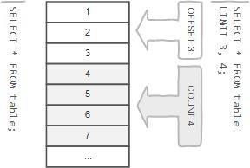
row limiting clause
LIMIT is applied after HAVING
Remember:
LIMIT enables you to pull a section of rows from the middle of a result set. Specify two values: The number of rows to skip at the beginning of the result set, and the number of rows to return.
Note:
Limit value are not to be given within ( . . . )
Limit takes one or two numeric arguments, which must both be non-negative integer value.

Slide 128
select - limit
SELECT A₁, A₂, A₃, . . . FROM r
[ LIMIT { [offset,] row_count | row_count OFFSET offset } ]
You can specify an offset using OFFSET from where SELECT will start returning records. By default offset is zero.
SELECT * FROM emp LIMIT 5 OFFSET 1;
READ
FROM
SELECT
LIMIT
1, 5 | 5 offset 1
output
emp
identifier.*
SELECT * FROM student LIMIT 5;
SELECT * FROM student LIMIT 1, 5;
SELECT * FROM student LIMIT 5 offset 1;
SELECT RAND(), student.* FROM student ORDER BY 1 LIMIT 1;
SELECT student.* FROM student ORDER BY RAND() LIMIT 1;

Slide 129
Nulls by default occur at the top, but you can use IsNull to assign default values, that will put it in the position you require. . The ISNULL() function tests whether an expression is NULL. If expression is a NULL value, the ISNULL() function returns 1. Otherwise, it returns 0.
SELECT id AS 'a' FROM tbl_name ORDER BY `a`;
SELECT id AS 'a' FROM tbl_name ORDER BY 'a';
order by clause
SQL allows the user to order the tuples in the result of a query by the values of one or more of the attributes that appear in the query result, by using the ORDER BY clause.
Remember:
The default sort order is ascending ASC, with smallest values first. To sort in descending (reverse) order, add the DESC keyword to the name of the column you are sorting by.
You can sort on multiple columns, and you can sort different columns in different directions.
If the ASC or DESC modifier is not provided in the ORDER BY clause, the results will be sorted by expression in ASC (ascending) order. This is equivalent to ORDER BY expression ASC.

Slide 130
select - order by
When doing an ORDER BY, NULL values are placed first if you do ORDER BY ... ASC and last if you do ORDER BY ... DESC.
SELECT A₁, A₂, A₃, A_{n} FROM r
[ORDER BY {A₁, A₂, A₃, . . . | expr | position} [ASC | DESC] , . . . ]
"Ordered by attributes A₁, A₂, A₃ …"
Tuples are sorted by specified attributes
Results are sorted by A₁ first
Within each value of A₁, results are sorted by A₂ then within each value of A₂, results are sorted by A₃
SELECT * FROM r ORDER BY key_part1, key_part2; // optimizer does not use the index.
SELECT key_part1, key_part2 FROM r ORDER BY key_part1, key_part2; // optimizer uses the index.

Slide 131
select - order by
The ORDER BY clause is used to sort the records in your result set.
SELECT A₁, A₂, A₃, A_{n} FROM r
[ORDER BY {A₁, A₂, A₃, . . . | expr | position} [ASC | DESC] , . . . ]
READ
FROM
SELECT
ORDER BY
identifier.job ASC, identifier.ename DESC
output
identifier.*
emp
READ
FROM
SELECT
ORDER BY
identifier.job DESC, identifier.ename ASC
output
identifier.ename, identifier.job
emp

Slide 132
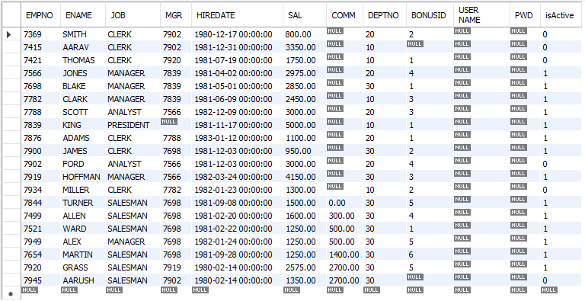
select - order by
When doing an ORDER BY, NULL values are presented first if you do ORDER BY ... ASC
SELECT * FROM emp ORDER BY comm ASC;

Slide 133
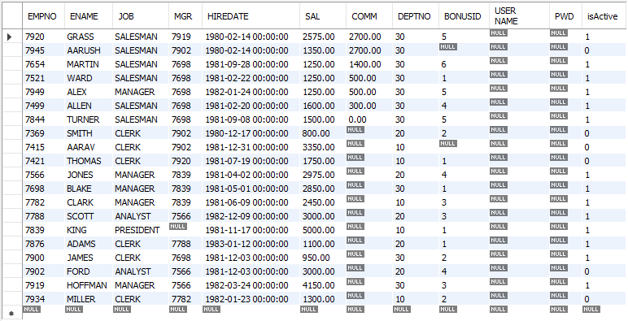
select - order by
When doing an ORDER BY, NULL values are presented last if you do ORDER BY ... DESC.
SELECT * FROM emp ORDER BY comm DESC;

Slide 134
select - order by
SELECT A₁, A₂, A₃, A_{n} FROM r
[ORDER BY {A₁, A₂, A₃, . . . | expr | position} [ASC | DESC] , . . . ]
SELECT * FROM emp ORDER BY comm;
SELECT * FROM emp ORDER BY comm IS NULL ;
SELECT * FROM emp ORDER BY comm IS NOT NULL ;
SELECT * FROM emp ORDER BY 1 + 1;
SELECT * FROM emp ORDER BY True;
SELECT sal FROM emp ORDER BY -sal;
SELECT ename, LENGTH(ename) FROM emp ORDER BY LENGTH(ename), ename DESC ;
SELECT * FROM emp ORDER BY IF(job = 'manager', 3, IF(job = 'salesman', 2, NULL)) ;
SELECT * FROM emp ORDER BY FIELD(job, 'manager', 'salesman') ;
SELECT * FROM emp ORDER BY ISNULL(comm), comm ;
SELECT ename `e` FROM emp ORDER BY `e` ;
SELECT ename `e` FROM emp ORDER BY e ;
SELECT ename 'e' FROM emp ORDER BY 'e' ;
SELECT * FROM emp ORDER BY CASE WHEN ename='sharmin' THEN 0 ELSE 1 END, ename;

Slide 135
Remember:
In WHERE clause operations can be performed using…
CONSTANTS
TABLE columns
FUNCTION calls (PRE-DEFINED / UDF)
In SQL, a logical expression is often called a predicate.
where clause
The WHERE Clause is used when you want to retrieve specific information from a table excluding other irrelevant data.
Note:
Expressions in WHERE clause can use.
Arithmetic operators
Comparison operators
Logical operators
Note:
All comparisons return FALSE when either argument is NULL, so no rows are ever selected.

Slide 136
select - where
We can use a conditional clause called WHERE clause to filter out results. Using WHERE clause, we can specify a selection criteria to select required records from a table.
SELECT A₁, A₂, A₃, . . . FROM r₁, r₂, r₃, . . . [ WHERE P ]
r_{i} are the relations (tables)
A_{i} are attributes (columns)
P is the selection predicate
SQL permits us to use the notation (v₁, v₂,...,v_{n}) to denote a tuple of arity (attribute) n containing values v₁, v₂,...,v_{n}.
WHERE (a₁, a₂) <= (b₁, b₂)
WHERE (EMP.DEPTNO, DNAME) = (DEPT.DEPTNO, 'SALES');
Remember:
A predicate is a condition expression that evaluates to a boolean value, either true or false.
Predicates can be used as follows: In a SELECT statement's WHERE clause or HAVING clause to determine which rows are relevant to a particular query.
A value of zero is considered false. Nonzero values are considered true.
SELECT true, false, TRUE, FALSE, True, False;

Slide 137
select - where
SELECT A₁, A₂, A₃, . . . FROM r₁, r₂, r₃, . . . [ WHERE P ]
comparison_operator:
= | <=> | >= | > | <= | < | <> | !=
logical_operators
{ AND | && } | { OR | || }
What will be the result of the query below?
WHERE state = 'NY' OR 'CA' --Illegal
WHERE salary > 20000 AND < 30000 –Illegal
WHERE state NOT = 'CA' --Illegal
SELECT 1 = 1;
SELECT True = 1;
SELECT True = 2;
SELECT True = True;
SELECT 0 = 0;
SELECT False = False;
SELECT False = 1;
SELECT 'a' = 1;
SELECT 'a' = 0;
SELECT * FROM emp WHERE ename = 0;
SELECT * FROM emp WHERE ename = 1;
SELECT * FROM emp WHERE ename = False;
SELECT * FROM emp WHERE ename = True;
SELECT * FROM emp WHERE True AND False;
SELECT * FROM emp WHERE True OR False;
SELECT * FROM emp WHERE True AND 1;
SELECT * FROM emp WHERE True OR 0;
Note:
AND has higher precedence than OR.
EXPLAIN ANALYZE SELECT * FROM emp WHERE job = 'salesman' OR job = 'manager' AND sal > 2000;

Slide 138
select - where
SELECT A₁, A₂, A₃, . . . FROM r₁, r₂, r₃, . . . [ WHERE P ]
Logical Operators
AND, && | Logical AND e.g. SELECT 1 AND 1; / SELECT 1 AND 0; SELECT 0 AND NULL; / SELECT NULL AND 0; SELECT 1 AND NULL; / SELECT NULL AND 1;
OR, || | Logical OR e.g. SELECT 1 OR 1; / SELECT 1 OR 0; SELECT 0 OR NULL; / SELECT NULL OR 0; SELECT 1 OR NULL; / SELECT NULL OR 1;
NOT, ! | Negates value e.g. SELECT NOT 1;
Logical AND. Evaluates to 1 if all operands are non-zero and not NULL, to 0 if one or more operands are 0, otherwise NULL is returned.
Logical OR. When both operands are non-NULL, the result is 1 if any operand is nonzero, and 0 otherwise. With a NULL operand, the result is 1 if the other operand is nonzero, and NULL otherwise. If both operands are NULL, the result is NULL.
Logical NOT. Evaluates to 1 if the operand is 0, to 0 if the operand is nonzero, and NOT NULL returns NULL.

Slide 139
select - where
SELECT A₁, A₂, A₃, . . . FROM r₁, r₂, r₃, . . . [ WHERE P ]
Comparison Functions and Operators
LEAST(value1, value2, . . .) | With two or more arguments, returns the smallest argument.
GREATEST(value1, value2, . . .) | With two or more arguments, returns the largest argument.
(expr, [expr] . . .) | Multiple columns in expr. (sub-query returning multiple columns to compare)
COALESCE(value, . . .) | Returns the first non-NULL value in the list, or NULL if there are no non-NULL values.
SELECT GREATEST(10, 20, 30), # 30
LEAST(10, 20, 30); # 10
SELECT GREATEST(10, null, 30), # null
LEAST(10, NULL , 30); # null
SELECT * FROM emp WHERE (deptno, pwd) = (SELECT deptno, pwd FROM dept WHERE deptno = 30);
Remember:
If any argument is NULL, the both functions return NULLs immediately without doing any comparison..

Slide 140
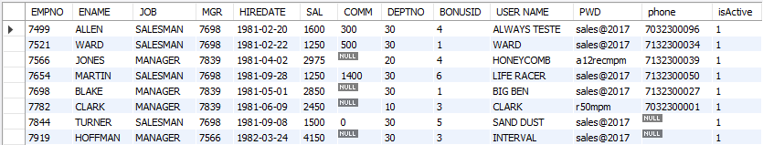
select - where
SELECT * FROM emp WHERE job = 'MANAGER' OR job = 'SALESMAN';
READ
FROM
WHERE
SELECT
identifier.job = 'MANAGER' or identifier.job = 'SALESMAN'
output
emp
identifier.*

Slide 141
combining and & or - where
Note:
AND has higher precedence than OR.
SELECT * FROM andor WHERE ename = 'saleel' AND city = 'pune' OR city = 'baroda';
SELECT * FROM andor WHERE ename = 'saleel' AND (city = 'pune' OR city = 'baroda');
SELECT ename, job, comm FROM emp WHERE comm = 0 OR comm IS NULL AND job = 'CLERK';
SELECT ename, job, comm FROM emp WHERE (comm = 0 OR comm IS NULL) AND job = 'CLERK';
EXPLAIN ANALYZE SELECT * FROM emp WHERE job = 'salesman' OR job = 'manager' AND sal > 2000;

Slide 142
select - where
SELECT A₁, A₂, A₃, . . . FROM r₁, r₂, r₃, . . . [ WHERE P ]
What will be the output of the following statement?
SELECT "Hello" # "World " FROM dual;
SELECT 10 + 10 as Result FROM dual WHERE False;
SELECT 10 + 10 as Result FROM dual WHERE True;
SELECT 10 + 10 as Result FROM dual WHERE 10 - 10;
SELECT 10 + 10 as Result FROM dual WHERE 10 - 0;
SELECT 10 + 10 as Result FROM dual WHERE 10 - 30;
SELECT '5' * '5' as Result FROM dual;
SELECT 5 * 5 - '-5' as Result FROM dual;

Slide 143
SELECT * FROM emp WHERE comm IS UNKNOWN;
SELECT * FROM emp WHERE comm IS NOT UNKNOWN;
operand IS [NOT] NULL
boolean_ predicate:
IS [NOT] NULL
| expr <=> null
is null / is not null
"IS NULL" is the keyword that performs the Boolean comparison. It returns true if the supplied value is NULL and false if the supplied value is not NULL.
“IS NOT NULL" is the keyword that performs the Boolean comparison. It returns true if the supplied value is not NULL and false if the supplied value is null.
SQL uses a three-valued logic: besides true and false, the result of logical expressions can also be unknown. SQL’s three valued logic is a consequence of supporting null to mark absent data.
Note:
IS UNKNOWN is synonym of IS NULL.
IS NOT UNKNOWN is synonym of IS NOT NULL.

Slide 144
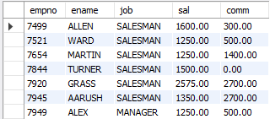
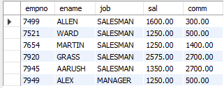
is null / is not null
Remember:
SELECT * FROM emp WHERE comm = NULL; # will return Empty set
SELECT empno, ename, job, sal, comm FROM emp WHERE comm IS NOT NULL;
SELECT empno, ename, job, sal, comm FROM emp WHERE comm IS NOT UNKNOWN;
SELECT empno, ename, job, sal, comm FROM emp WHERE comm is TRUE;

Slide 145
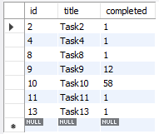
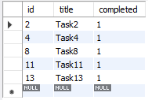
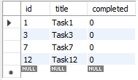
select – boolean
BOOL and BOOLEAN are synonym of TINYINT(1)
A value of zero is considered false. non-zero values are considered true.
SELECT true, false, TRUE, FALSE, True, False;
SELECT * FROM tasks WHERE completed;
SELECT * FROM tasks WHERE completed is True;
SELECT * FROM tasks WHERE completed = 1;
SELECT * FROM tasks WHERE completed = True;
SELECT * FROM tasks WHERE NOT completed;
SELECT * FROM tasks WHERE completed is False;
SELECT * FROM tasks WHERE completed = 0;
SELECT * FROM tasks WHERE completed = False;

Slide 146
select – boolean
BOOL and BOOLEAN are synonym of TINYINT(1)
A value of zero is considered false. Nonzero values are considered true.
SELECT true, false, TRUE, FALSE, True, False;
What will be the result of the query below?
SELECT * FROM emp WHERE 1;
SELECT * FROM emp WHERE True;
SELECT * FROM emp WHERE 0;
SELECT * FROM emp WHERE False;
SELECT * FROM emp WHERE ename = '' OR 0;
SELECT * FROM emp WHERE ename = '' OR 1;
SELECT * FROM emp WHERE ename = '' OR 1 = 1;
SELECT * FROM emp WHERE ename = 'smith' OR True;
SELECT * FROM emp WHERE ename = 'smith' AND True;
SELECT * FROM emp WHERE ename IN('smith', True);
SELECT * FROM emp WHERE ename = 'smith' OR False;
SELECT * FROM emp WHERE ename = 'smith' AND False;
SELECT * FROM emp WHERE ename IN('smith', False);

Slide 147
READ
FROM
WHERE
SELECT
identifier.state IN ('VT', 'NH', . . .)
output
states
identifier.*
predicate:
expr [NOT] IN (expr1, expr2, . . . )
| expr [NOT] IN (subquery)
in
The IN statement is used in a WHERE clause to choose items from a set. The IN operator allows you to determine if a specified value matches any value in a set of values or value returned by a subquery.
SELECT . . . FROM r₁ WHERE (
state = 'VT' OR
state = 'NH' OR
state = 'ME' OR
state = 'MA' OR
state = 'CT' OR
state = 'RI'
);
SELECT . . . FROM r₁ WHERE state IN ('VT', 'NH', 'ME', 'MA', 'CT', 'RI');
SELECT . . . FROM r₁ WHERE state IN (SELECT . . . );
A IN (B1, B2, B3, etc.) | A is found in the list (B1, B2, etc.)

Slide 148
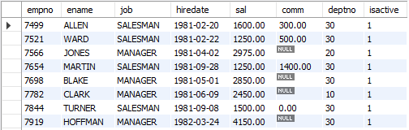
in
syntax
column | expression IN ( v1, v2, v3, . . . )
column | expression IN (subquery)
Remember:
If a value in the column or the expression is equal to any value in the list, the result of the IN operator is TRUE.
The IN operator is equivalent to multiple OR operators.
To negate the IN operator, you use the NOT IN operator.
SELECT empno, ename, job, hiredate, sal, comm, deptno, isactive FROM emp WHERE job IN ('salesman', 'manager');

Slide 149
not in
IN
Problem with NOT IN:
a
b
c1 | c2
1 | 1
2 | 1
3 | 1
4 | 1
5 | 1
c1 | c2
1 | 7
NULL | 7
3 | 7
SELECT * FROM a WHERE c1 NOT IN(1, 2, NULL);
SELECT * FROM a WHERE c1 NOT IN(SELECT c1 FROM b );
Empty set (0.00 sec)
"color NOT IN (Red, Blue, NULL)" This is equivalent to: "NOT(color=Red OR color=Blue OR color=NULL)"

Slide 150
in
IN
Remember:
On the left side of the IN() predicate, the row constructor contains only column references.
On the right side of the IN() predicate, there is more than one row constructor.
What will be the result of the query below?
SELECT * FROM emp WHERE deptno IN (10);
SELECT * FROM emp WHERE deptno IN (10, 20);
SELECT * FROM emp WHERE False IN (10, 20, 0);
SELECT * FROM emp WHERE True IN (10, 20, 1);
SELECT * FROM emp WHERE 10 IN (10, 20);
SELECT * FROM emp WHERE 7788 IN (empno, mgr); ←
SELECT * FROM emp WHERE 1 IN (10, 20, True, False);
SELECT * FROM emp WHERE deptno IN (10, 20) OR True;
SELECT * FROM emp WHERE deptno IN (10, 20) AND True;
SELECT * FROM emp WHERE deptno IN (SELECT deptno FROM dept);
SELECT * FROM emp WHERE deptno IN (SELECT deptno FROM dept WHERE dname='accounting');
SELECT * FROM emp WHERE deptno IN (TABLE deptno); # ERROR 1241 (21000): Operand should contain 1 column(s)
SELECT * FROM emp WHERE 1 NOT IN (NULL);
SELECT * FROM emp WHERE deptno IN (10, 20);
SELECT * FROM emp WHERE False IN (10, 20, 0);
SELECT * FROM emp WHERE True IN (10, 20, 1);
SELECT * FROM emp WHERE 10 IN (10, 20);

Slide 151
READ
FROM
WHERE
SELECT
output
emp
identifier.sal BETWEEN
1000 and 3000
identifier.*
predicate:
expr [NOT] BETWEEN expr1 AND expr2
between
The BETWEEN operator is a logical operator that allows you to specify a range to test.
A BETWEEN B AND C | A is between B and C

Slide 152
between
syntax
WHERE salary BETWEEN ( 20000 AND 30000 ) – Illegal
column | expression BETWEEN start_expression AND end_expression
Remember:
The BETWEEN operator returns TRUE if the expression to test is greater than or equal to the value of the start_expression and less than or equal to the value of the end_expression.
You can use the greater than or equal to (>=) and less than or equal to (<=) to substitute the BETWEEN operator.
Note:
if any input to the BETWEEN or NOT BETWEEN is NULL, then the result is UNKNOWN.
e.g.
SELET empno, ename, job, hiredate, sal, comm, deptno, isactive FROM emp WHERE sal BETWEEN 1000 AND NULL;
SELECT * FROM salespeople WHERE FORMAT(comm, 2) > 0.1 AND FORMAT(comm, 2) < 0.26;

Slide 153
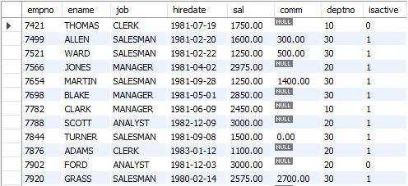
between
SELECT empno, ename, job, hiredate, sal, comm, deptno, isactive FROM emp WHERE sal BETWEEN 1000 AND 3000;

Slide 154
READ
FROM
WHERE
SELECT
output
identifier.ename LIKE 'a%'
identifier.*
emp
predicate:
expr [NOT] LIKE expr [ESCAPE char]
like
The LIKE operator is a logical operator that tests whether a string contains a specified pattern or not.

Slide 155
like - string comparison functions
syntax
column | expression LIKE 'pattern' [ESCAPE escape_character]
Remember:
% matches any number of characters, even zero characters.
_ matches exactly one character.
If we use default escape character '\', then don’t use ESCAPE keyword.
Note:
The ESCAPE keyword is used to escape pattern matching characters such as the (%) percentage and underscore (_) if they form part of the data.
If you do not specify the ESCAPE character, \ is assumed.

Slide 156
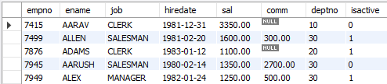
like
SELECT empno, ename, job, hiredate, sal, comm, deptno, isactive FROM emp WHERE ename LIKE 'a%';

Slide 157
like
What will be the result of the query below?
SELECT * FROM emp WHERE ename LIKE 's%';
SELECT * FROM emp WHERE 'saleel' LIKE 's%';
SELECT * FROM emp WHERE True LIKE '1';
SELECT * FROM emp WHERE True LIKE '1%';
SELECT * FROM emp WHERE True LIKE 001;
SELECT * FROM emp WHERE True LIKE 100;
SELECT * FROM emp WHERE False LIKE 100 OR 0;
SELECT * FROM emp WHERE False LIKE 0 AND 1;

Slide 158
READ
FROM
GROUP BY
SELECT
output
identifier.job
AVG(sal), SUM(sal), MAX(sal), MIN(sal), COUNT(*)
emp
aggregate functions
SUM, AVG, MAX, MIN, COUNT, and GROUP_CONCAT
SELECT . . . . . FROM table_name WHERE <condition> / GROUP BY column_name
this is invalid
SET SQL_MODE = ' ';
SET SQL_MODE = IGNORE_SPACE;
SUM(colNM) / AVG(colNM) / MAX(colNM)
MIN(colNM) / COUNT(*) / COUNT(colNM)
Remember:
None of the below two queries get executed unsuccessfully. The reason is that a condition in a WHERE clause cannot contain any aggregate function (or group function) without a subquery!
SELECT empno, ename, sal, deptno FROM emp WHERE sal = MAX(sal); #error
SELECT empno, ename, sal, deptno FROM emp WHERE MAX(sal) = sal; #error

Slide 159
aggregate functions
Remember:
There are 3 places where aggregate functions can appear in a query.
in the SELECT-LIST/FIELD-LIST (the items before the FROM clause).
in the ORDER BY clause.
in the HAVING clause.
Note:
The aggregate functions allow you to perform the calculation of a set of rows and return a single value.
The WHERE clause cannot refer to aggregate functions. e.g. WHERE SUM(sal) = 5000 # Invalid, Error
The HAVING clause can refer to aggregate functions. e.g. HAVING SUM(sal) = 5000 # Valid, No Error
Nesting of aggregate functions are not allowed.
e.g.
SELECT MAX(COUNT(*)) FROM emp GROUP BY deptno;
Blank space between aggregate functions like (SUM, MIN, MAX, COUNT) are not allowed.
e.g.
SELECT SUM (sal) FROM emp;
The GROUP BY clause is often used with an aggregate function to perform calculation and return a single value for each subgroup.
To eliminate duplicates before applying the aggregate function is available by including the keyword DISTINCT.

Slide 160
aggregate functions
Things to… Remember:
TODO
AVG([DISTINCT] expr)
If there are no matching rows, AVG() returns NULL.
AVG() may take a numeric argument, and it returns a average of non-NULL values.
e.g.
SELECT AVG(1) "R1";
SELECT AVG(NULL) "R1";
SELECT AVG(1) "R1" WHERE True;
SELECT AVG(1) "R1" WHERE False;
SELECT AVG(1) "R1" FROM emp;
SELECT AVG(sal) "R1" FROM emp WHERE empno = -1;
SELECT AVG(sal) "Avg Salary" FROM emp;
SELECT job, AVG(sal) "Avg Salary" FROM emp GROUP BY job;

Slide 161
aggregate functions
Things to… Remember:
TODO
SUM([DISTINCT] expr)
If there are no matching rows, SUM() returns NULL.
SUM() may take a numeric argument , and it returns a sum of non-NULL values.
e.g.
SELECT SUM(1) "R1";
SELECT SUM(NULL) "R1";
SELECT SUM(2 + 2 * 2);
SELECT SUM(1) "R1" WHERE True;
SELECT SUM(1) "R1" WHERE False;
SELECT SUM(1) "R1" FROM emp;
SELECT SUM(sal) "R1" FROM emp WHERE empno = -1;
SELECT SUM(sal) "Total Salary" FROM emp;
SELECT job, SUM(sal) "Total Salary" FROM emp GROUP BY job;

Slide 162
aggregate functions
Things to… Remember:
TODO
SUM([DISTINCT] expr)
If there are no matching rows, SUM() returns NULL.
SUM() may take a numeric argument , and it returns a sum of non-NULL values.
r = { -2, 1, 2, -1, 3, -2, 1, 2, 1 }
SELECT SUM(c1) "R1" FROM r;
SELECT SUM(IF(c1 >= 0, c1, NULL)) FROM r;
SELECT SUM(IF(c1 < 0, c1, NULL)) FROM r;
SELECT custId, type, amount, CASE type WHEN 'd' THEN amount WHEN 'c' THEN amount * -1 END amount FROM transactions;

Slide 163
aggregate functions
Things to… Remember:
TODO
MAX([DISTINCT] expr)
If there are no matching rows, MAX() returns NULL.
MAX() may take a string, number, and date argument, and it returns a maximum of non-NULL values.
e.g.
SELECT MAX(1) "R1";
SELECT MAX(NULL) "R1";
SELECT MAX('VIKAS');
SELECT MAX(1) "R1" WHERE True;
SELECT MAX(1) "R1" WHERE False;
SELECT MAX(1) "R1" FROM emp;
SELECT MAX(sal) "R1" FROM emp WHERE empno = -1;
SELECT MAX(sal) "Maximum Salary" FROM emp;
SELECT job, MAX(sal) "Maximum Salary" FROM emp GROUP BY job;

Slide 164
aggregate functions
Things to… Remember:
TODO
MIN([DISTINCT] expr)
If there are no matching rows, MIN() returns NULL.
MIN() may take a string, number, and date argument, and it returns a minimum of non-NULL values.
e.g.
SELECT MIN(1) "R1";
SELECT MIN(NULL) "R1";
SELECT MIN(1) "R1" WHERE True;
SELECT MIN(1) "R1" WHERE False;
SELECT MIN(1) "R1" FROM emp;
SELECT MIN(sal) "R1" FROM emp WHERE empno = -1;
SELECT MIN(sal) "Minimum Salary" FROM emp;
SELECT job, MIN(sal) "Minimum Salary" FROM emp GROUP BY job;

Slide 165
aggregate functions
Things to… Remember:
TODO
COUNT([DISTINCT] expr)
If there are no matching rows, COUNT() returns 0.
Returns a count of the number of non-NULL values.
COUNT(*) is somewhat different in that it returns a count of the number of rows retrieved, whether or not they contain NULL values.
COUNT (*) is a special implementation of the COUNT function that returns the count of all the rows in a specified table.
COUNT (*) also considers Nulls and duplicates.
SQL does not allow the use of DISTINCT with COUNT (*)
Note:
COUNT (*): Returns a number of rows in a table including duplicates rows and rows containing null values in any of the columns.
COUNT (EXP): Returns the number of non-null values in the column identified by expression.
COUNT (DISTINCT EXP): Returns the number of unique, non-null values in the column identified by expression.
COUNT (DISTINCT *): is illegal.

Slide 166
aggregate functions
Things to… Remember:
TODO
COUNT([DISTINCT] expr)
e.g.
SELECT COUNT(*) "R1";
SELECT COUNT(NULL) "R1";
SELECT COUNT(*) "R1" WHERE True;
SELECT COUNT(*) "R1" WHERE False;
SELECT COUNT(0) FROM emp;
SELECT COUNT(1) FROM emp;
SELECT COUNT(*) FROM emp WHERE empno = -1;
SELECT COUNT(comm) "R1" FROM emp;
SELECT job, COUNT(*) "R1" FROM emp GROUP BY job;

Slide 167
aggregate functions
Things to… Remember:
TODO
GROUP_CONCAT([DISTINCT] expr
[ORDER BY {unsigned_integer | col_name | expr} [ASC | DESC] [,col_name . . .]]
[SEPARATOR str_val])
e.g.
SELECT job, GROUP_CONCAT(ename) FROM emp GROUP BY job;
SELECT deptno, GROUP_CONCAT(ename) FROM emp group BY deptno;
SELECT job, CONCAT(GROUP_CONCAT(ename),' (', COUNT(*), ')') FROM emp GROUP BY job;
SELECT job, CONCAT(GROUP_CONCAT(sal),' (', MAX(sal), ')') FROM emp GROUP BY job;
SELECT job, CONCAT(GROUP_CONCAT(sal),' (', SUM(sal), ')') FROM emp GROUP BY job;

Slide 168

SET SQL_MODE = '';
SET SQL_MODE = 'ONLY_FULL_GROUP_BY';
^{G}A_{1,} A_{2,} . . ., A_{n,} ^{G}F₁(A₁), F₂(A₂), . . ., F_{m}(A_{m}) ^{(r)}
group by clause
Remember:
Standard SQL does not allow you to use an ALIAS in the GROUP BY clause, however, MySQL supports this.
GROUP BY is used in conjunction with aggregating functions to group the results by the unaggregated columns.
Note:
DISTINCT (if used outside an aggregation function) that is superfluous.
e.g.
SELECT DISTINCT COUNT(ename) FROM emp;

Slide 169
select - group by
Columns selected for output can be referred to in ORDER BY and GROUP BY clauses using column names, column aliases, or column positions. Column positions are integers and begin with 1
If you use GROUP BY, output rows are sorted according to the GROUP BY columns as if you had an ORDER BY for the same columns. To avoid the overhead of sorting that GROUP BY produces, add ORDER BY NULL.
If a query includes GROUP BY but you want to avoid the overhead of sorting the result, you can suppress sorting by specifying ORDER BY NULL.
For example:
SELECT job, COUNT(*) FROM emp GROUP BY job ORDER BY NULL;
SELECT * FROM emp ORDER BY FIELD (job, 'MANAGER', 'SALESMAN');

Slide 170
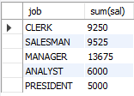
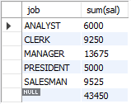
select - group by
This function's will produce a single value for an entire group or a table.
You can use GROUP BY to group values from a column, and, if you wish, perform calculations on that column.
SELECT G₁, G₂, . . . , F₁(A₁), F₂(A₂), . . . FROM r₁, r₂, . . .
[GROUP BY {G₁, G₂, . . . | expr | position}, . . . [WITH ROLLUP]]
SELECT job, SUM(sal) FROM emp GROUP BY job;
SELECT job, SUM(sal) FROM emp GROUP BY job WITH ROLLUP;
READ
FROM
GROUP BY
SELECT
job
output
identifier.job
identifier.Job, SUM(sal)
emp

Slide 171
select - group by
SET SQL_MODE = '';
SET SQL_MODE = 'ONLY_FULL_GROUP_BY';
Examples:
SELECT job, sal + 1001 FROM emp GROUP BY job;
SELECT job, COUNT(job) FROM emp GROUP BY COUNT(job); # error
SELECT job, sal + 1001 FROM emp GROUP BY sal + 1001;
SELECT LENGTH(ename) R1 FROM emp GROUP BY R1;
SELECT job, SUM(sal) FROM emp GROUP BY job WITH ROLLUP;
SELECT COALESCE (job, 'Total'), SUM(sal) FROM emp GROUP BY job WITH ROLLUP;

Slide 172
Remember:
The WHERE clause cannot refer to aggregate functions. [ WHERE SUM(sal) = 5000 # Error ]
The HAVING clause can refer to aggregate functions. [ HAVING SUM(sal) = 5000 # No Error ]
having clause
The MySQL HAVING clause is used in the SELECT statement to specify filter conditions for a group of rows. HAVING clause is often used with the GROUP BY clause. When using with the GROUP BY clause, we can apply a filter condition to the columns that appear in the GROUP BY clause.
Note:
Columns given in HAVING clause must be present in selection-list.
e.g.
SELECT COUNT(*) FROM emp HAVING deptno=10; *
SELECT deptno, COUNT(*) FROM emp GROUP BY deptno HAVING job='manager'; *
HAVING is merged with WHERE if you do not use GROUP BY or Aggregate Functions (COUNT(), . . .)
* ERROR: Unknown column '. . .' in 'having clause'

Slide 173

select - having
SELECT G₁, G₂, . . . , F₁(A₁), F₂(A₂), . . . FROM r₁, r₂, . . .
[GROUP BY {G₁, G₂, . . . | expr | position}, . . . [WITH ROLLUP]]
[HAVING having_condition ]
SELECT COUNT(*), job FROM emp GROUP BY job HAVING COUNT(*) > 2;
READ
FROM
GROUP BY
HAVING
SELECT
identifier.job
COUNT(*) > 2
identifier.job, COUNT(*)
output
emp

Slide 174
When WHERE and HAVING clause are used together in a SELECT query with aggregate function, WHERE clause is applied first on individual rows and only rows which pass the condition is included for creating groups. Once group is created, HAVING clause is used to filter groups based upon condition specified.
difference between where and having clause

Slide 175
where and having clause
Remember:
WHERE clause can be used with - SELECT, UPDATE, and DELETE statements, where as HAVING clause can only be used with the SELECT statement.
WHERE clause filters rows before aggregation (GROUPING), where as, HAVING clause filters groups, after the aggregations are performed.
WHERE is used before the ‘GROUP BY’ clause if required and HAVING is used after the ‘GROUP BY’ clause.
Aggregate functions (SUM, MIN, MAX, AVG and COUNT) cannot be used in the WHERE clause, unless it is in a sub query contained in a WHERE or HAVING clause, whereas, aggregate functions can be used in HAVING clause.
Note:
The WHERE clause acts as a pre-filter where as HAVING clause acts as a post-filter.

Slide 176
where vs having
WHERE
VS
HAVING
WHERE | HAVING
Implemented in row operations. | Implemented in column operations.
Single row | Summarized row or group or rows.
It only fetches the data from particular rows or table according to the condition. | It only fetches the data from grouped data according to the condition.
Aggregate Functions ccannot appear in WHERE clause. | Aggregate Functions Can appear in HAVING clause.
Used with SELECT and other statements such as UPDATE, DELETE or either one of them. | Used with SELECT statement only.
Pre-filter | Post-filter
GROUP BY Comes after WHERE. | GROUP BY Comes before HAVING.

Slide 177
window function

Slide 178
window function
Use ORDER BY expr with PARTITION BY expr to see the effect of PARTITION BY expr.
RANK() OVER(PARTITION BY expr [, expr] . . . ORDER BY expr [ASC|DESC] [, expr [ASC|DESC]] . . . )
DENSE_RANK() OVER(PARTITION BY expr [, expr] . . . ORDER BY expr [ASC|DESC] [, expr [ASC|DESC]] . . . )
ROW_NUMBER() OVER([ PARTITION BY expr [, expr] . . . ORDER BY expr [ASC|DESC] [, expr [ASC|DESC]] . . . ] )
Note:
MySQL does not support these window function features.
DISTINCT syntax for aggregate functions.
Nested window functions
Window function cannot be the part of WHERE condition

Slide 179
window function- examples
FIFA / Forbes
SELECT ROW_NUMBER() OVER() R1, emp.* FROM emp;
SELECT RANK() OVER(PARTITION BY job ORDER BY sal) R1, ename, sal, job FROM emp;
SELECT DENSE_RANK() OVER(PARTITION BY job ORDER BY sal) R1, ename, sal, job FROM emp;
SELECT ordid, total, SUM(total) OVER(ORDER BY ordid) FROM ord;
SELECT * FROM (SELECT ROW_NUMBER() OVER() R1, emp.* FROM emp) d WHERE R1> (SELECT COUNT(*) - 2 FROM emp);
SELECT custId, type, amount, CASE type WHEN 'd' THEN amount WHEN 'c' THEN amount * -1 END amount FROM transactions;
SELECT year, quarter, amount, SUM(amount) OVER(PARTITION BY year ORDER BY quarter) R1 FROM quarter_revenue;
SELECT custId, type, amount, SUM(CASE type WHEN 'd' THEN amount WHEN 'c' THEN amount * -1 END) OVER(PARTITION BY custID ORDER BY _id) amount FROM transactions;

Slide 180
user-defined variables

Slide 181
user-defined variables
TODO
Remember:
A user variable name can contain other characters if you quote it as a string or identifier (for example, @'my-var', @"my-var", or @`my-var`).
User-defined variables are session specific. A user variable defined by one client cannot be seen or used by other clients.
All variables for a given client session are automatically freed when that client exits.
User variable names are not case sensitive. Names have a maximum length of 64 characters.
If the value of a user variable is selected in a result set, it is returned to the client as a string.
If you refer to a variable that has not been initialized, it has a value of NULL and a type of string.
e.g. SELECT @variable_name;

Slide 182
user-defined variables
You can store a value in a user-defined variable in one statement and refer to it later in another statement. This enables you to pass values from one statement to another.
SET @variable_name = expr [, @variable_name = expr] . . .
Remember:
for SET, either = or := can be used as the assignment operator.
You can also assign a value to a user variable in statements (SELECT, …) other than SET. In this case, the assignment operator must be := and not = because latter is treated as the comparison operator =.
set @v1 = 1001, @v2 := 2, @v3 = 'Saleel';
set @v1 = 1001, @v2 = 2, @v3 := @v1 + @v2;
SELECT @v1 := MIN(sal), @v2 := MAX(SAL) FROM emp;
SELECT @v1, @v2, @v3;

Slide 183

user-defined variables
Note:
User variables are intended to provide data values. They cannot be used directly in an SQL statement as an identifier or as part of an identifier.
e.g.
SET @v1 = 'ENAME'; #WHERE ENAME IS COLUMN NAME.
SELECT @v1 FROM emp;

Slide 184
rownum
mysql> SELECT * FROM (SELECT @cnt := @cnt + 1 "R1", emp.* FROM emp, (SELECT @cnt := 0) T1) T2 WHERE "R1" > @cnt - 7;

Slide 185
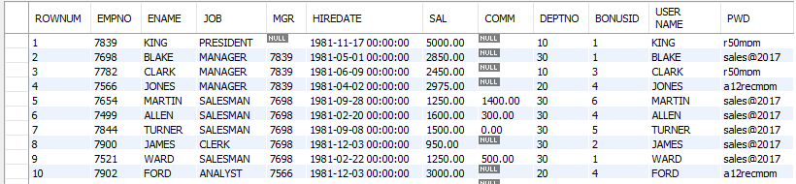
select - rownum
mysql> SET @rank = 0;
mysql> SELECT @row := @row + 1 as rownum , emp.* FROM emp;
mysql> SELECT @row := @row + 1 as rownum , emp.* FROM emp, (SELECT @row := 0) as E;
mysql> SELECT @row := @row + 1 ,E.* FROM (SELECT job, sal FROM emp GROUP BY job ORDER BY SAL DESC) E , (SELECT @row := 0) EE;

Slide 186
common sql statements mistakes
Examples:
SELECT ename, job, sal, comm FROM emp WHERE comm = NULL; #using comparison operator to check NULL
SELECT job, COUNT(job) FROM emp; #not giving group by clause
SELECT job, COUNT(job) FROM emp WHERE COUNT(job) > 4; #use of aggregate function in where clause
SELECT job, deptno, COUNT(job) FROM emp GROUP BY job; #not giving all the columns in group by clause
SELECT ename, COUNT(job) FROM emp GROUP BY ename; #grouping by a unique key
SELECT ename, sal, sal + 1000 R1 FROM emp WHERE R1 > 2400; #use of alias name in where clause
SELECT ename, sal FROM emp WHERE sal BETWEEN (1000 and 4000); #use of () in between comparison operator
r1 = { col1, col2, col3 }
INSERT INTO r1 VALUSE(10, 10); #number of values are less than the number of columns in the table
INSERT INTO r1 VALUSE(10, 10, 10, 10); #number of values are more than the number of columns in the table

Slide 187
joins

Slide 188
joins
JOINS are used to retrieve data from multiple tables.
JOIN is performed whenever two or more tables are joined in a SQL statement.

Slide 189
joins
Type of JOINS
Cartesian or Product Join – Cross Join
Equijoin – Inner Join
Natural Join
Simple Join
Outer Join – Right Outer Join, Left Outer Join
Self Join

Slide 190
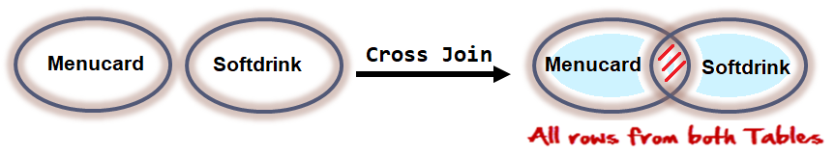
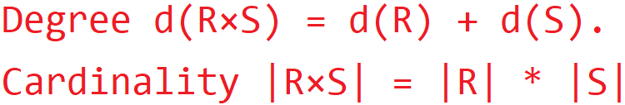
cartesian or product join
Cartesian/Product means Number of Rows present in Table 1 Multiplied by Number of Rows present in Table 2.
Cross Join in MySQL does not require any common column to join two table.
The result of R(A₁, A₂, . . . , A_{n}) × S(B₁, B₂, . . . , B_{m}) is a relation Q with degree n + m attributes Q(A₁, A₂, . . . , A_{n} , B₁, B₂, . . . , B_{m}), in that order.

Slide 191
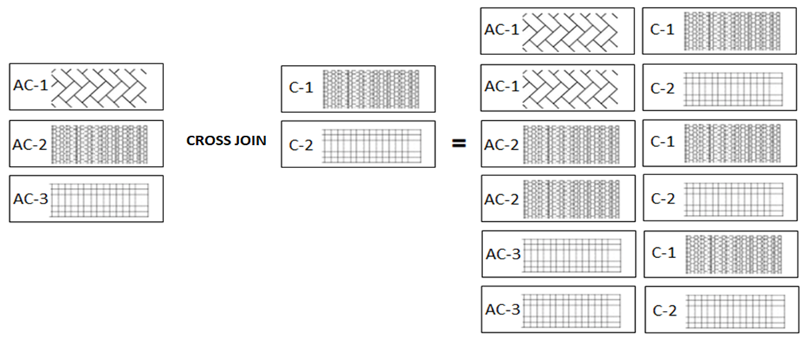
joins - cartesian or product
The CROSS JOIN gets a row from the first table (r₁) and then creates a new row for every row in the second table (r₂). It then does the same for the next row for in the first table (r₁) and so on.

Slide 192
joins - cartesian or product
Cartesian or Product joins are joins without a join condition. Each row of one table is combined with each row of another table. The result is referred to as a Cartesian product.
Warehouse/product
Product/sales_channel
Cards
SELECT A₁, A₂, A₃, . . . FROM r₁, r₂, . . .
r₁ = {1, 2}
r₂ = {a, b, c}
r₁ x r₂
R = { (1, a),
(2, a),
(1, b),
(2, b),
(1, c),
(2, c) }
r₁ = {1, 2, 3}
r₂ = {a, b}
r₁ x r₂
R = { (1, a),
(1, b),
(2, a),
(2, b),
(3, a),
(4, b) }
r₁ = {1, 2}
r₂ = {a, b, null}
r₁ x r₂
R = { (1, a),
(2, a),
(1, b),
(2, b),
(1, null),
(2, null) }

Slide 193
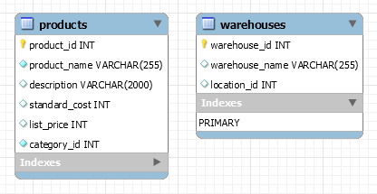
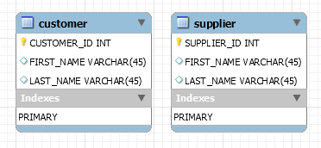
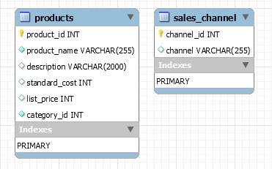
joins - cartesian or product
Cartesian or Product joins are joins without a join condition. Each row of one table is combined with each row of another table. The result is referred to as a Cartesian product.
SELECT A₁, A₂, A₃, . . . FROM r₁, r₂, . . .
X
X
X
Warehouse/product
Product/sales_channel
Person/Cards

Slide 194
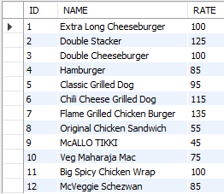
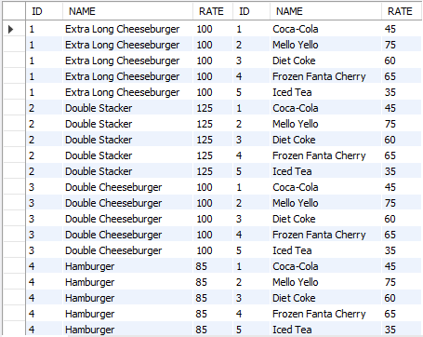
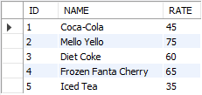
joins - cartesian or product
SELECT A₁, A₂, A₃, . . . FROM r₁, r₂, . . .
SELECT * FROM menucard, softdrink;

Slide 195
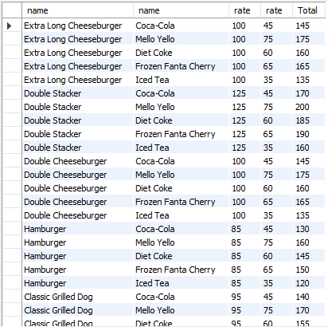
joins - cartesian or product
SELECT A₁, A₂, A₃, . . . FROM r₁, r₂, . . .
SELECT mnu.name, sftdrink.name, mnu.rate, sftdrink.rate, mnu.rate + sftdrink.rate as "Total" FROM menucard mnu, softdrink sftdrink;

Slide 196
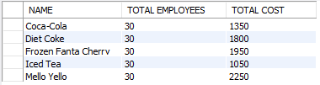
joins - cartesian or product
SELECT name, COUNT(*) "Total Employees", rate * COUNT(*) "Total Cost" FROM emp, softdrink GROUP BY name;

Slide 197
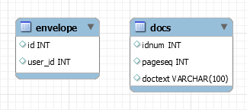


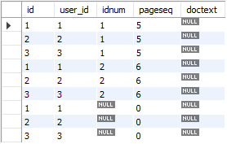
joins – cross join
The CROSS JOIN produced a result set which is the product of rows of two associated tables when no WHERE clause is used with CROSS JOIN. In this join, the result set appeared by multiplying each row of the first table with all rows in the second table if no condition introduced with CROSS JOIN.
SELECT A₁, A₂, A₃, . . . FROM r₁ CROSS JOIN r₂, . . .
envelope Table
docs Table
SELECT * FROM envelope CROSS JOIN docs;

Slide 198
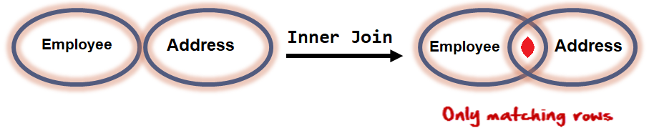
equi join
An equi join / Inner Join is a join with a join condition containing an equality operator. An equijoin returns only those rows that have equivalent values for the specified columns. Rows that match remain in the result, those that don't are rejected. The match condition is commonly called the join condition. equi join / Inner Join returns rows when there is at least one match in both tables.
The result of R(A₁, A₂, . . . , A_{n}) _{<join condition>} S(B₁, B₂, . . . , B_{m}) is a relation Q with degree n + m attributes Q(A₁, A₂, . . . , A_{n} , B₁, B₂, . . . , B_{m}), in that order. Q has one tuple for each combination of tuples—one from R and one from S—whenever the combination satisfies the join condition.

Slide 199
employeeID | Name | deptNo
1 | Saleel | 10
2 | Sharmin | 20
3 | Vrushali | 10
deptNo | Name
10 | Sales
20 | Accounting
30 | Manager
employeeID | Name | deptNo | deptNo | Name
1 | Saleel | 10 | 10 | Sales
2 | Sharmin | 20 | 20 | Accounting
3 | Vrushali | 10 | 10 | Sales

Slide 200
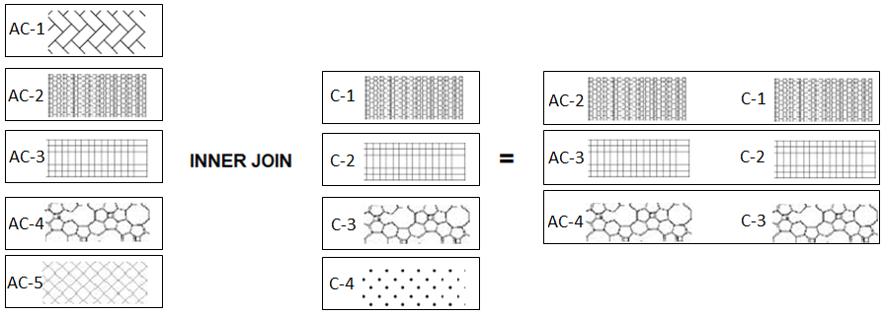
equi join example
The following table illustrates the inner join of two tables r₁(AC-1, AC-2, AC-3, AC-4, AC-5) and r₂(C-1, C-2, C-3, C-4). The result includes rows: (2,A), (3,B), and (4,C) as they have the same patterns.

Slide 201
joins – equi join
EQUI JOIN performs a JOIN against equality or matching column(s) values of the associated tables. An equal sign (=) is used as comparison operator in the where clause to refer equality.
SELECT A₁, A₂, A₃, . . . FROM r₁, r₂ WHERE r₁. A₁ = r₂. A₁
r₁ = { 1, 2, 3, 4 }
r₂ = { (1, a), (2, b), (1, c), (3, d), (2, e), (1, f) }
r₁ = r₂
R = {(1,1,a),
(2,2,b),
(1,1,c),
(3,3,d),
(2,2,e),
(1,1,f)}
Remember:
A general join condition is of the form <condition> AND <condition> AND . . . AND <condition>, where each <condition> is of the form Ai θ Bj, Ai is an attribute of R, Bj is an attribute of S.

Slide 202
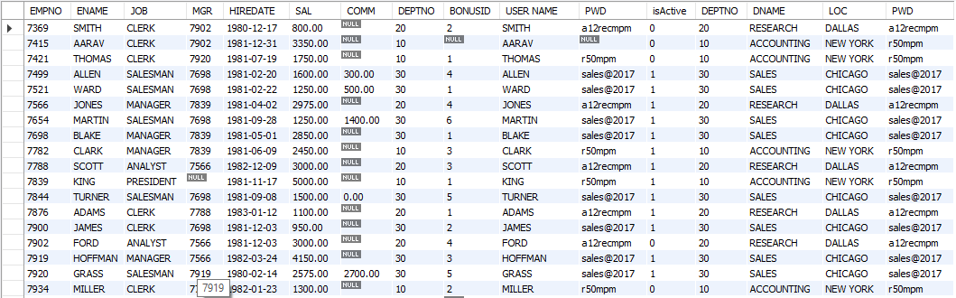
joins – equi join
SELECT * FROM emp , dept WHERE emp.deptno = dept.deptno;
Remember:
SELECT * FROM emp, dept WHERE emp.deptno = dept.deptno AND dname = 'accounting';
SELECT * FROM emp, dept WHERE (emp.deptno, dname) = (dept.deptno, 'accounting');

Slide 203
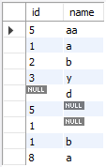
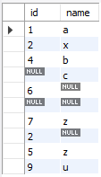
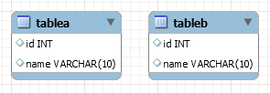
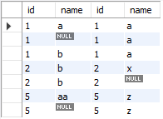

tableA Table
joins – equi join
tableB Table
SELECT * FROM tableA , tableB WHERE tableA.id = tableB.id;
SELECT * FROM tableA , tableB WHERE tableA.name = tableB.name;

Slide 204
ON Contrition
When this join condition gets applied none of the columns of the relation will get eliminated in the result set.
In order to apply this join condition, on any two tables they need not to have any common column.
on condition and using attribute
USING Attribute Contrition
When all the common columns are used in the join predicate then the result would be same as Natural join.
In the result set of the join the duplicates of the columns used in the predicate gets eliminated.
It should not have a qualifier(table name or Alias) in the referenced columns.
Note:
ON clause is optional, If not given then INNER JOIN works like CROSS JOIN.

Slide 205

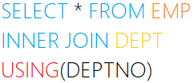
joins – on & using clause example
The ON clause
The ON clause is used to join tables where the column names don’t match in both tables.
JOINING CONDITION
The USING clause
The USING clause is used if several columns share the same name but you don’t want to join using all of these common columns. The columns listed in the USING clause can’t have any qualifiers in the statement.
JOINING CONDITION

Slide 206
inner join
The inner join is one of the most commonly used joins in SQL. The inner join clause allows you to query data from two or more related tables.

Slide 207
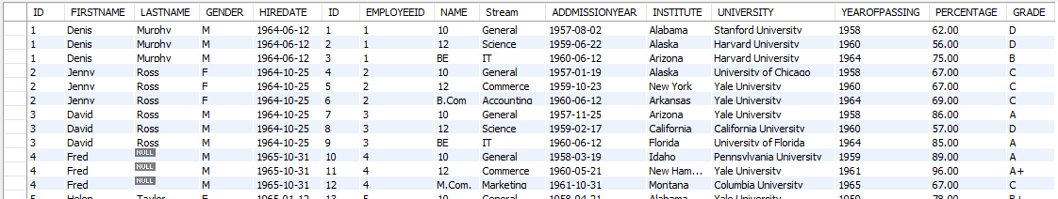
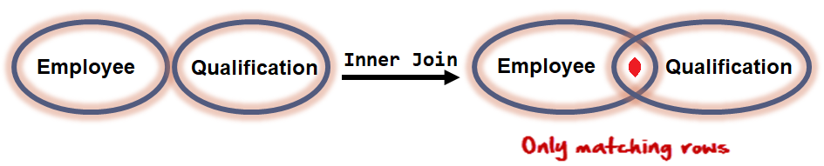
joins – inner join
INNER JOIN returns rows when there is at least one match in both tables.
The INNER JOIN selects all rows from both participating tables as long as there is a match between the columns. An SQL INNER JOIN is same as JOIN clause, combining rows from two or more tables.
SELECT A₁, A₂, A₃, . . . FROM r₁ [INNER] JOIN r₂ ON r₁. A₁ = r₂. A₁
SELECT * FROM employee emp INNER JOIN qualification quali ON emp.id = quali.employeeid;
ON clause is optional, If not given then INNER JOIN works like CROSS JOIN

Slide 208
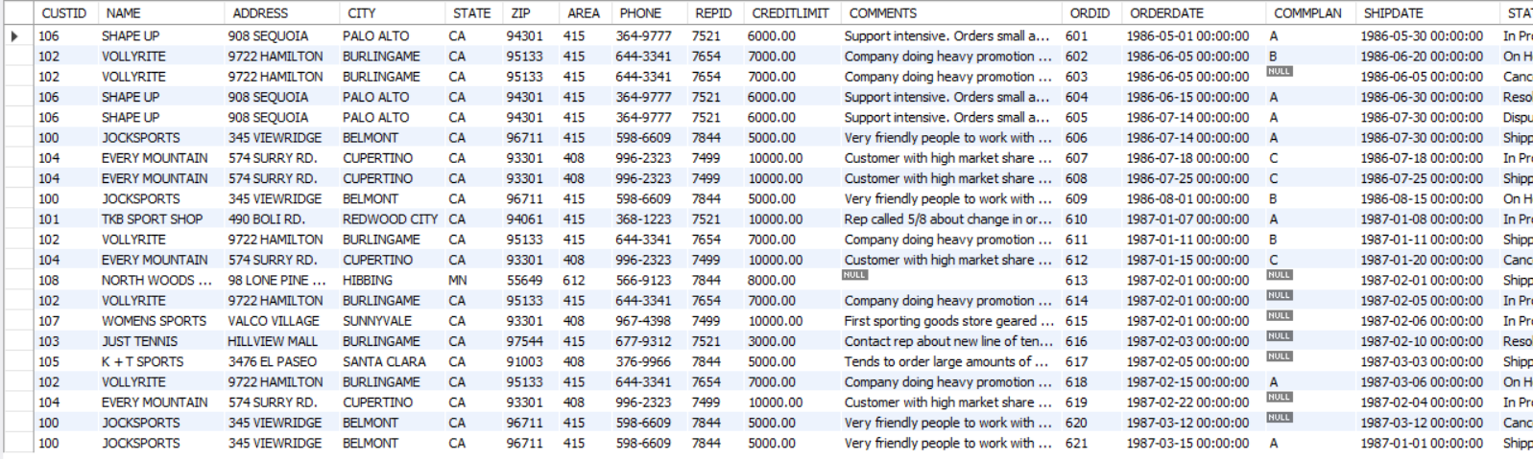
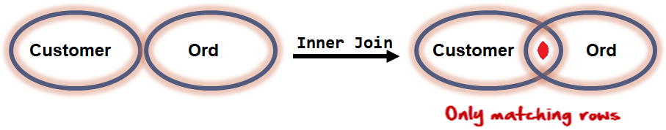
joins – inner join
INNER JOIN returns rows when there is at least one match in both tables.
The INNER JOIN selects all rows from both participating tables as long as there is a match between the columns. An SQL INNER JOIN is same as JOIN clause, combining rows from two or more tables.
SELECT A₁, A₂, A₃, . . . FROM r₁ [INNER] JOIN r₂ ON r₁. A₁ = r₂. A₁
SELECT * FROM customer INNER JOIN ord USING (custid);
ON clause is optional, If not given then INNER JOIN works like CROSS JOIN

Slide 209
In general, the join condition for NATURAL JOIN is constructed by equating each pair of join attributes that have the same name in the two relations and combining these conditions with AND.
natural join
The NATURAL JOIN is such a join that performs the same task as an INNER JOIN. NATURAL JOIN does not use any comparison operator. We can perform a NATURAL JOIN only if there is at least one common attribute that exists between two relations. In addition, the attributes must have the same name. When this join condition gets applied always the duplicates of the common columns get eliminated from the result.
Remember:
The standard definition of NATURAL JOIN requires that the two join attributes (or each pair of join attributes) have the same name in both relations. If this is not the case, a renaming operation is applied first.
e.g.
SELECT * FROM r NATURAL JOIN (SELECT a1 AS c1, a2 FROM s) t1;

Slide 210

joins – natural join
Joins two tables based on common column names. Hence one must confirm the common columns before using a NATURAL JOIN
The NATURAL JOIN is such a join that performs the same task as an INNER JOIN.
SELECT A₁, A₂, A₃, . . . FROM r₁ NATURAL [INNER] JOIN r₂ NATURAL [INNER] JOIN r₃ . . .
SELECT * FROM emp NATURAL JOIN dept;
The associated tables have one or more pairs of identically column-names.
The columns must be of the same name.
The columns datatype may differ.
Don't use ON / USING clause in a NATURAL JOIN.
When this join condition gets applied always the duplicates of the common columns get eliminated from the result.
A NATURAL JOIN can be used with a LEFT OUTER join, or a RIGHT OUTER join.
If the column-names are not same, then NATURAL JOIN will work as CROSS JOIN.

Slide 211
inner join vs natural join
INNER
VS
NATURAL
INNER JOIN | NATURAL JOIN
Inner Join joins two table on the basis of the column which is explicitly specified in the ON clause. | Natural Join joins two tables based on same attribute name.
In Inner Join, The resulting table will contain all the attribute of both the tables including duplicate columns also | In Natural Join, The resulting table will contain all the attributes of both the tables but keep only one copy of each common column
In Inner Join, only those records will return which exists in both the tables | Same as Inner Join
SYNTAX: SELECT * FROM r₁ INNER JOIN r₂ ON r₁.A₁ = r₂.A₁; SELECT * FROM r₁ INNER JOIN r₂ USING(A₁, [A₂]); | SYNTAX: SELECT * FROM r₁ NATURAL JOIN r₂;

Slide 212
simple join
TODO

Slide 213
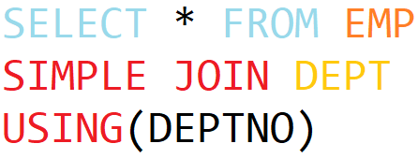
joins – simple join
The SIMPLE JOIN is such a join that performs the same task as an INNER JOIN.
SELECT A₁, A₂, A₃, . . . FROM r₁ SIMPLE JOIN r₂ USING (A₁, . . . )
SELECT * FROM emp SIMPLE JOIN dept USING(deptno)
JOINING CONDITION

Slide 214
The ON clause is required for a left or right outer join.
The LEFT OUTER JOIN operation keeps every tuple in the first, or left, relation R in R S, if no matching tuple is found in S, then the attributes of S in the join result are filled or padded with NULL values.
The RIGHT OUTER JOIN keeps every tuple in the second, or right, relation S in the result of R S, if no matching tuple is found in R, then the attributes of R in the join result are filled or padded with NULL values.
outer joins
In an outer join, along with rows that satisfy the matching criteria, we also include some or all rows that do not match the criteria.
CREATE TABLE r1 (id INT, c1 VARCHAR(10));
CREATE TABLE r2 (id INT, c1 VARCHAR(10));
INSERT INTO r1 VALUES (4,'AC-1'), (1,'AC-2'),(2,'AC-3'),(3,'AC-4'),(5,'AC-5');
INSERT INTO r2 VALUES (1,'C-1'), (2,'C-2'),(3,'C-3'),(7,'C-4');

Slide 215
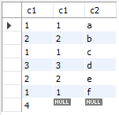
Suppose, we want to join two tables: r1 and r2. SQL left outer join returns all rows in the left table (r1) and all the matching rows found in the right table (r2). It means the result of the SQL left join always contains the rows in the left table. . If no matching rows found in the right table, NULL are displayed.
left outer joins
r₁ = {1, 2, 3, 4}
r₂ = {(1, a), (2, b), (1, c), (3, d), (2, e), (1, f), (5, z)}
r₁ left join r₂
R = {(1, 1, a),
(2, 2, b),
(1, 1, c),
(3, 3, d),
(2, 2, e),
(1, 1, f),
(4, NULL, NULL}
SELECT * FROM r1 LEFT JOIN r2 ON r1.c1 = r2.c1;

Slide 216

joins – left outer join
The following example the LEFT JOIN of two tables r₁(AC-1, AC-2, AC-3, AC-4, AC-5) and r₂(C-1, C-2, C-3, C-4). The LEFT JOIN will match rows from the r₁ table with the rows from r₂ table using patterns:

Slide 217

joins – left outer join
The LEFT JOIN keyword returns all rows from the left table (r₁), with the matching rows in the right table (r₂). The result is NULL in the right side when there is no match.
SELECT A₁, A₂, A₃, . . . FROM r₁ LEFT [OUTER] JOIN r₂ ON r₁. A₁ = r₂. A₁
SELECT * FROM orders ord LEFT OUTER JOIN employee emp ON emp.id = ord.employeeid;

Slide 218

joins – left outer join
SELECT * FROM student LEFT OUTER JOIN student_order ON student.id = student_order.studentid ;

Slide 219

joins – left outer join
The LEFT JOIN keyword returns all rows from the left table (r₁), with the matching rows in the right table (r₂). The result is NULL in the right side table when there is no match.
SELECT A₁, A₂, A₃, . . . FROM r₁ LEFT [OUTER] JOIN r₂ ON r₁. A₁ = r₂. A₁ WHERE r₂. A₁ IS NULL
SELECT * FROM orders ord LEFT OUTER JOIN employee emp ON emp.id = ord.employeeid WHERE emp.id IS NULL;

Slide 220

joins – left outer join
SELECT * FROM student LEFT OUTER JOIN student_order ON student.id = student_order.studentid WHERE student_order.studentID IS NULL;

Slide 221
joins – left outer join
The LEFT JOIN keyword returns all rows from the left table (r₁), with the matching rows in the right table (r₂). The result is NULL in the right side table when there is no match.
SELECT A₁, A₂, A₃, . . . FROM r₁ LEFT [OUTER] JOIN r₂ USING (A₁, . . .)
SELECT * FROM emp LEFT OUTER JOIN dept USING(deptno);
SELECT A₁, A₂, A₃, . . . FROM r₁ NATURAL LEFT [OUTER ] JOIN r₂
SELECT * FROM emp NATURAL LEFT OUTER JOIN dept;

Slide 222

Suppose, we want to join two tables: r1 and r2. Right outer join returns all rows in the right table (r1) and all the matching rows found in the left table (r2). It means the result of the SQL right join always contains the rows in the right table. . If no matching rows found in the left table, NULL are displayed.
right outer joins
r₁ = {1, 2, 3, 4}
r₂ = {(1, a), (2, b), (1, c), (3, d), (2, e), (1, f), (5, z)}
r₁ right join r₂
R = {(1, 1, a),
(1, 1, c),
(1, 1, f),
(2, 2, b),
(2, 2, e),
(3, 3, d),
(NULL, 5, z)}
SELECT * FROM r1 RIGHT JOIN r2 ON r1.c1 = r2.c1;

Slide 223

joins – right outer join
The following example the RIGHT OUTER JOIN of two tables r₁(AC-1, AC-2, AC-3, AC-4, AC-5) and r₂(C-1, C-2, C-3, C-4). The RIGHT JOIN will match rows from the r₁ table with the rows from r₂ table using patterns:

Slide 224

joins – right outer join
The RIGHT JOIN keyword returns all rows from the right table (r₂), with the matching rows in the left table (r₁). The result is NULL in the left side table when there is no match.
SELECT A₁, A₂, A₃, . . . FROM r₁ RIGHT [OUTER] JOIN r₂ ON r₁. A₁ = r₂. A₁
SELECT * FROM orders ord RIGHT OUTER JOIN employee emp ON emp.id = ord.employeeid;

Slide 225

joins – right outer join
SELECT * FROM student RIGHT OUTER JOIN student_order ON student.id = student_order.studentid;

Slide 226

joins – right outer join
The RIGHT JOIN keyword returns all rows from the right table (r₂), with the matching rows in the left table (r₁). The result is NULL in the left side table when there is no match.
SELECT A₁, A₂, A₃, . . . FROM r₁ RIGHT [OUTER] JOIN r₂ ON r₁. A₁ = r₂. A₁ WHERE r₁. A₁ IS NULL
SELECT * FROM orders ord RIGHT OUTER JOIN employee emp ON emp.id = ord.employeeid WHERE ord.employeeid IS NULL;

Slide 227

joins – right outer join
SELECT * FROM student RIGHT OUTER JOIN student_order ON student.id = student_order.studentid WHERE student.ID IS NULL;

Slide 228
joins – right outer join
The RIGHT JOIN keyword returns all rows from the right table (r₂), with the matching rows in the left table (r₁). The result is NULL in the left side table when there is no match.
SELECT A₁, A₂, A₃, . . . FROM r₁ RIGHT [OUTER] JOIN r₂ USING (A₁, . . .)
SELECT * FROM emp RIGHT OUTER JOIN dept USING(deptno);
SELECT A₁, A₂, A₃, . . . FROM r₁ NATURAL RIGHT [OUTER ] JOIN r₂
SELECT * FROM emp NATURAL RIGHT OUTER JOIN dept;

Slide 229
left join vs right join
LEFT JOIN
VS
RIGHT JOIN
LEFT OUTER JOIN | RIGHT OUTER JOIN | FULL OUTER JOIN
All the tuples of the left table remain in the result. | All the tuples of the right table remain in the result. | All the tuples from left as well as right table remain in the result.
The tuples of left table that does not have a matching tuple in right table are extended with NULL value for attributes of the right table. | The tuples of right table that does not have a matching tuple in left table are extended with NULL value for attributes of the left table. | The tuples of left as well as the right table that does not have the matching tuples in the right and left table respectively are extended with NULL value for attributes of the right and left tables.

Slide 230
TODO
self joins
TODO

Slide 231
joins – self join
A SELF JOIN is a join in which a table is joined with itself (which is also called Unary relationships), especially when the table has a FOREIGN KEY which references its own PRIMARY KEY.
SELECT r_{x}.A₁, r_{x}.A₂, r_{y}.A₁, r_{y}.A₂, . . . FROM r₁ r_{x}, r₁ r_{y} WHERE r_{x}.A₁ = r_{y}.A₁
SELECT distinct e1.* FROM emp e1 , emp e2 WHERE e1.sal = e2.sal AND e1.empno != e2.empno ORDER BY e1.sal;

